Slide 1

Pointers to more effective
software & data in audio research
Mark D Plumbley, Chris Cannam, Steve Welburn
Centre for Digital Music
Queen Mary, University of London
Notes:
(This presentation has notes)

Slide 2
Research software: The Question
  “How do you know your code implements your method at all?”

Slide 3
Validation and verification
Validation: Establishing how well your model represents reality
Research papers are expected to do this

Slide 4
Validation and verification
Validation: Establishing how well your model represents reality
Research papers are expected to do this
Verification: Establishing that you have implemented your model
This is what formal software testing is about
It's also what most informal good practice aims at
Research papers seldom attempt any of this

Slide 5
“Feedback cycles”
Write code → learn how code is wrong → fix code
Software development “best practice” is often about trying to shorten or simplify this cycle
Learn about your mistakes as early as possible

Slide 6


Slide 7
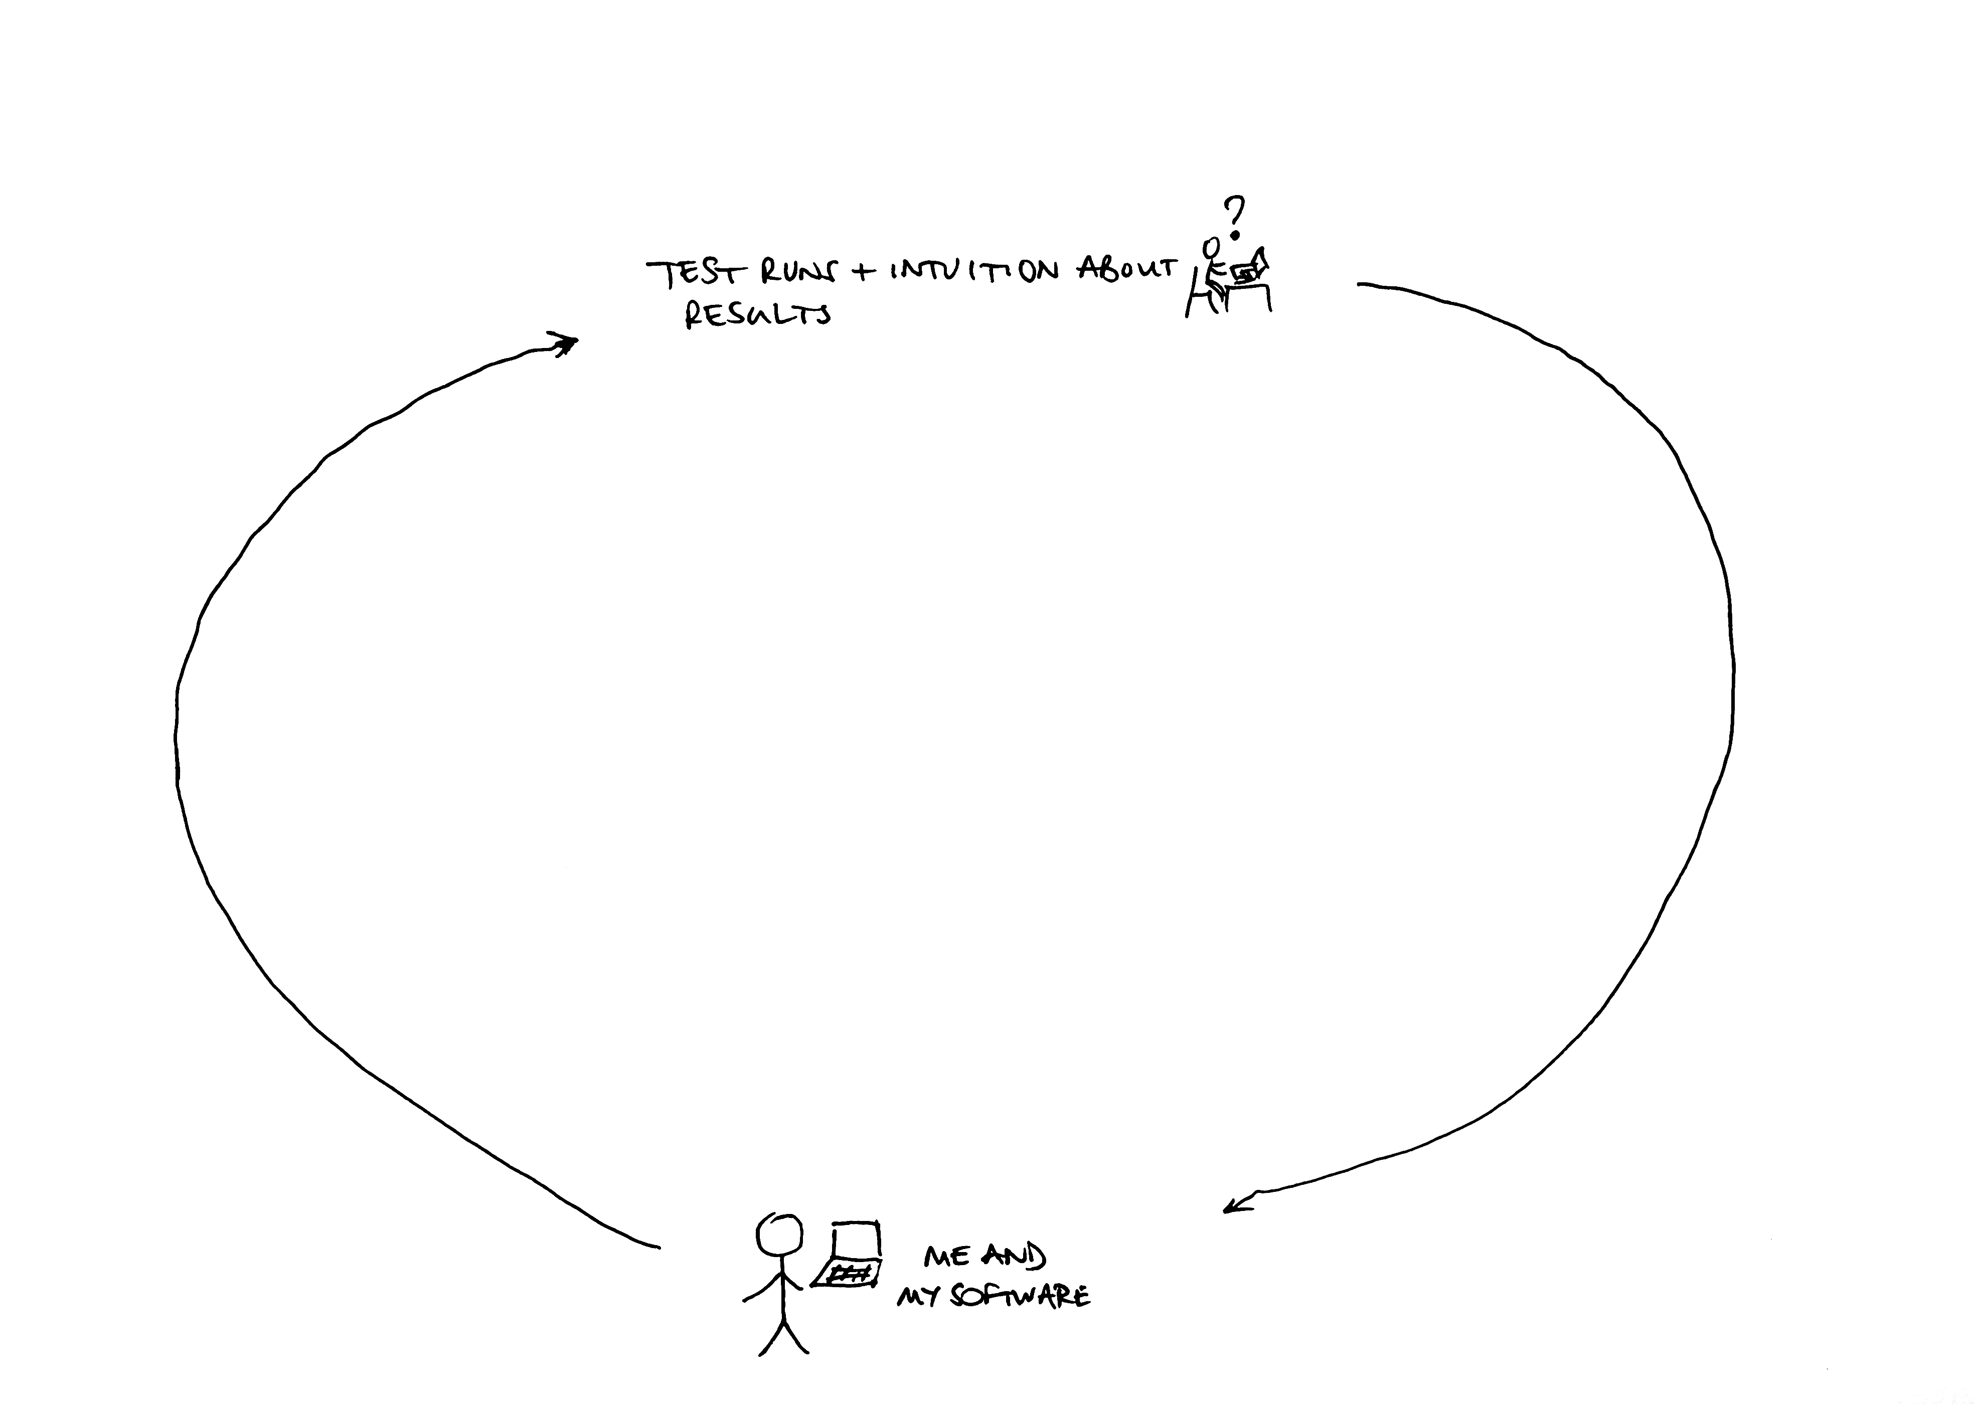

Slide 8
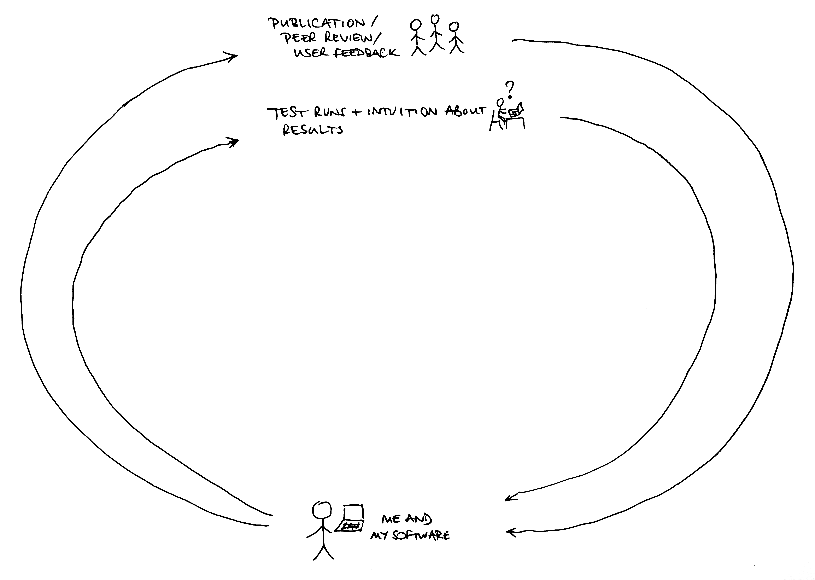

Slide 9
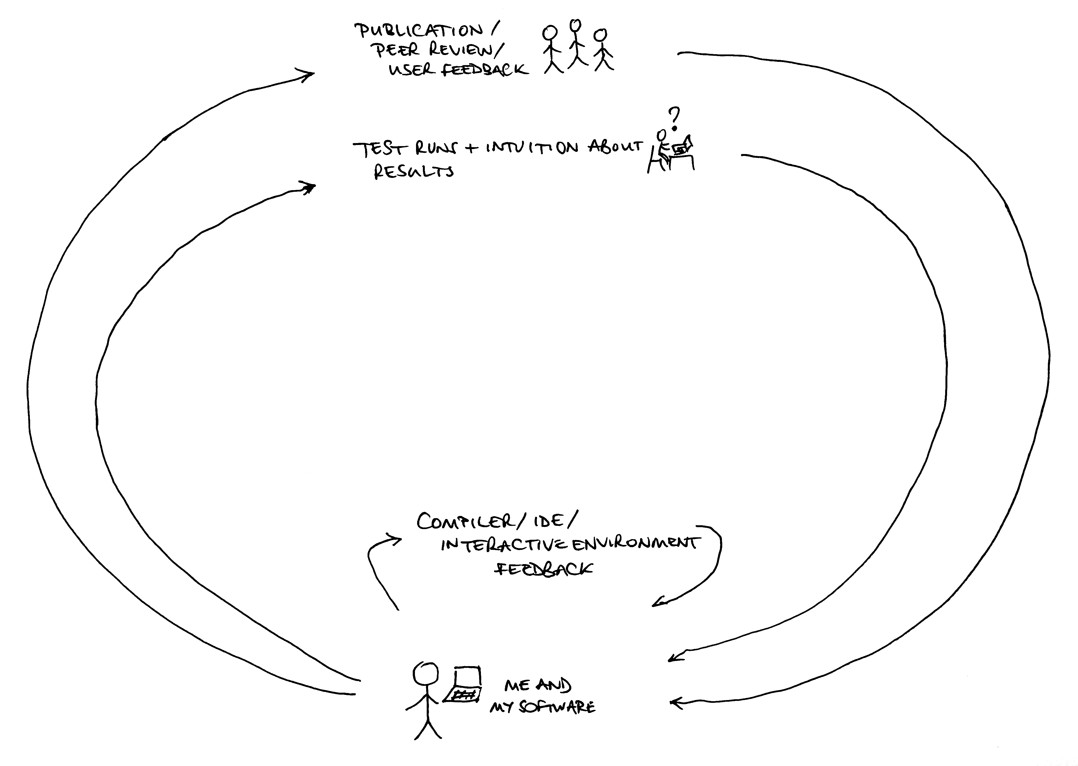

Slide 10
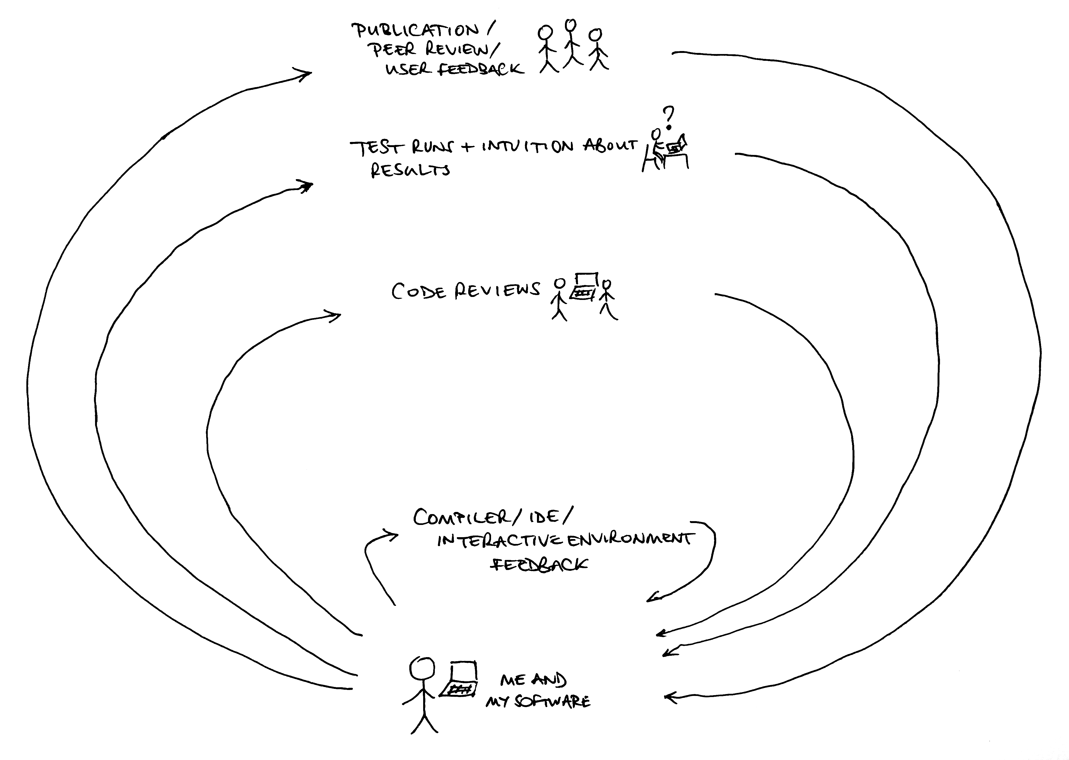

Slide 11
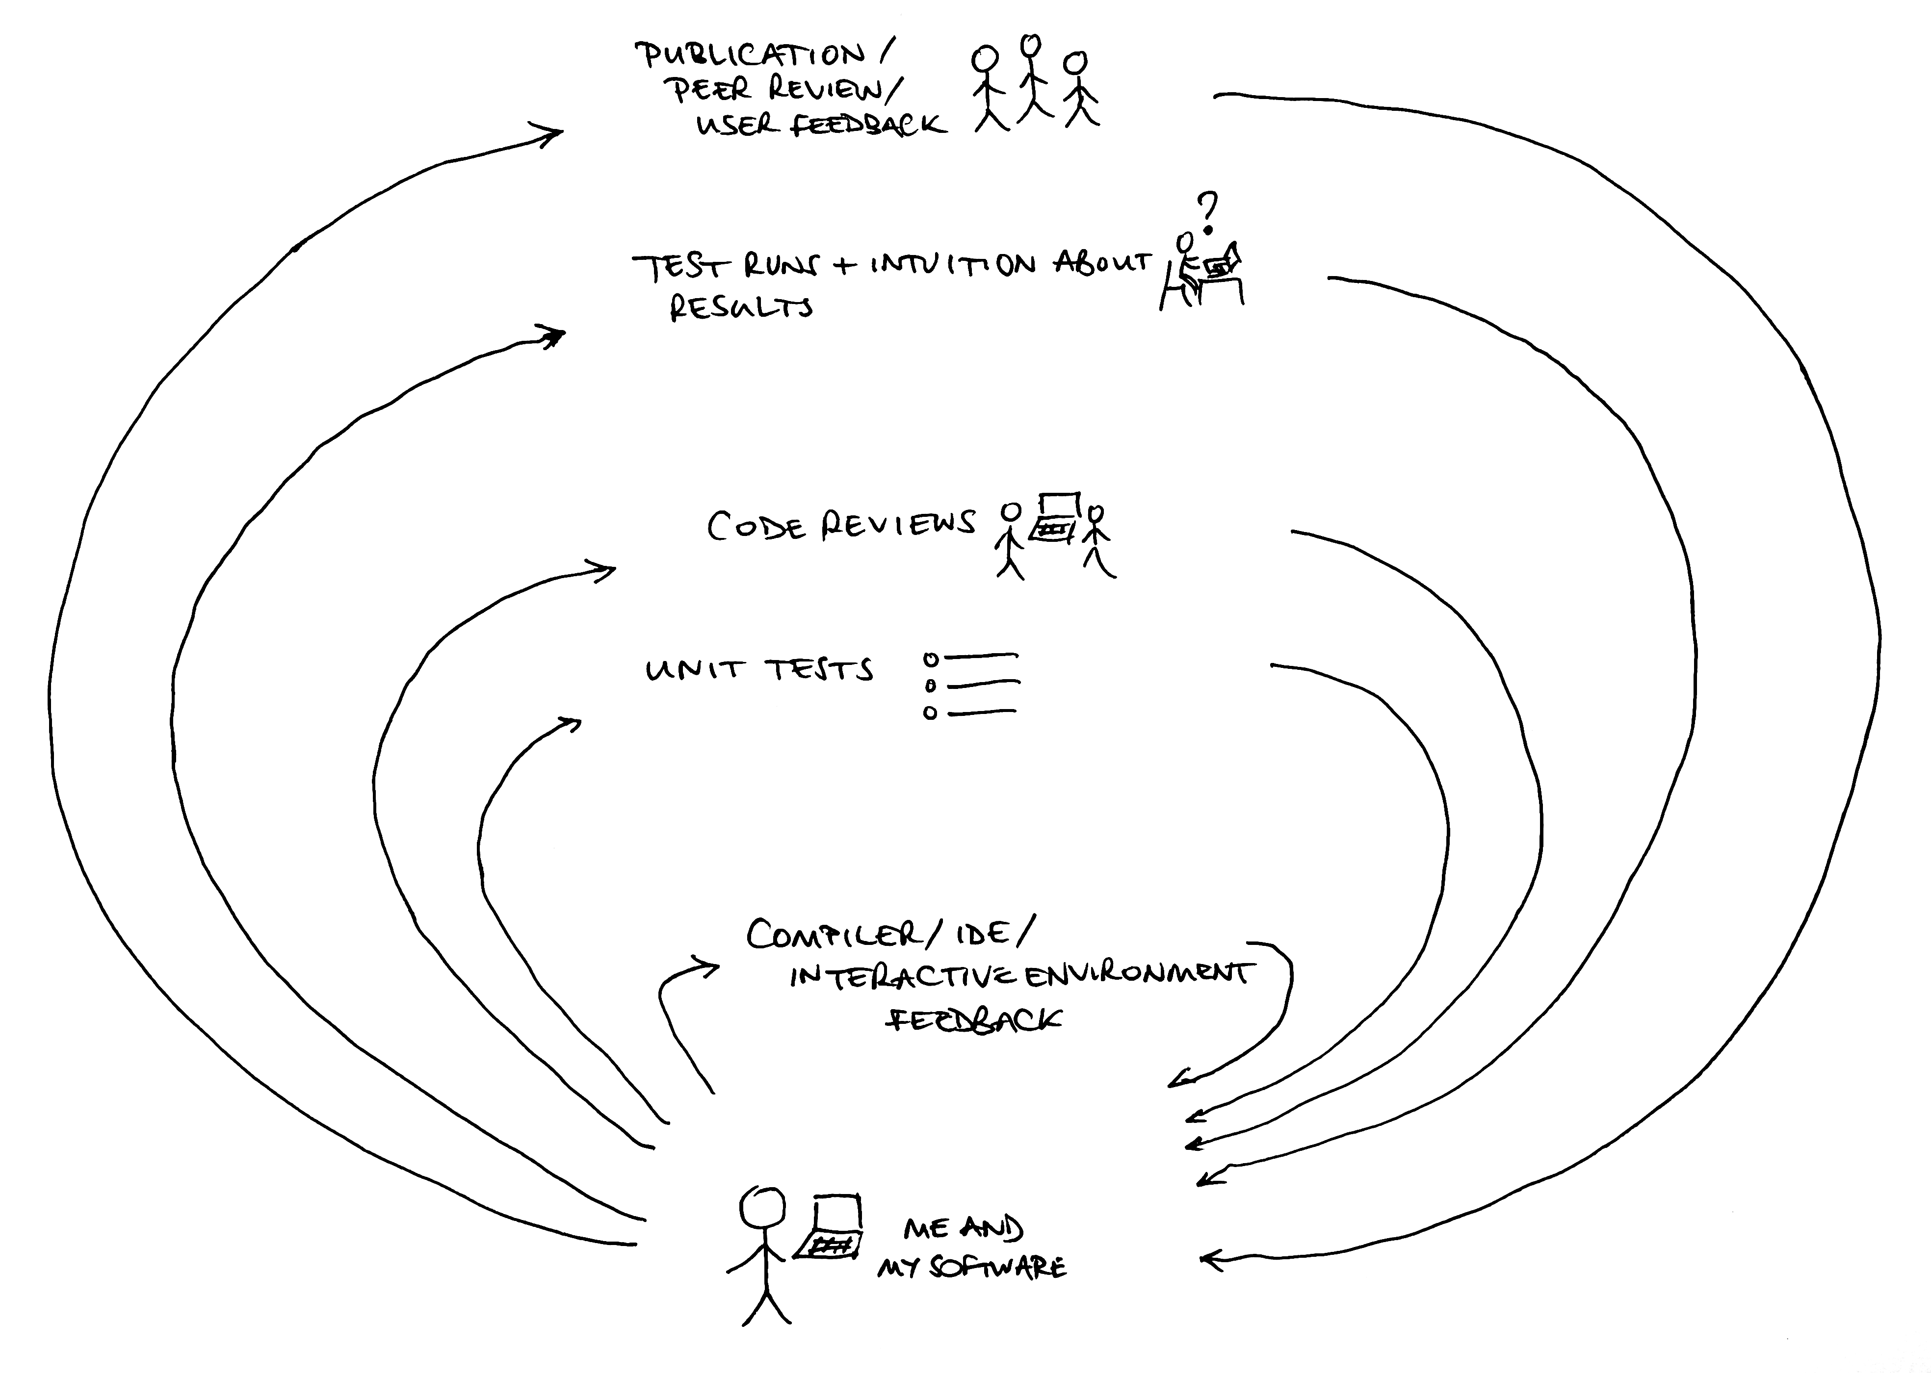

Slide 12
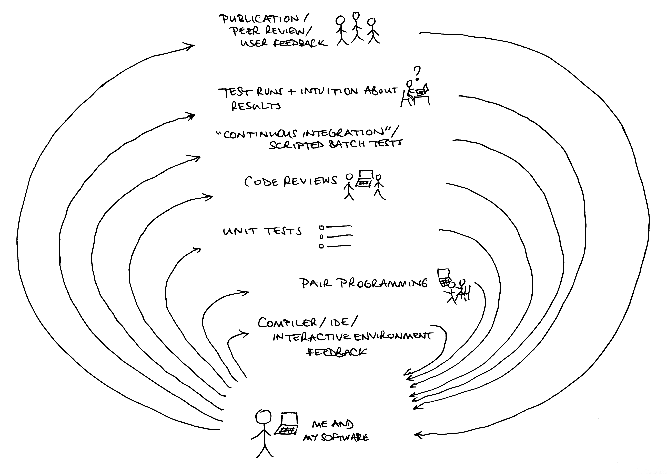

Slide 13
A philosophical point
Much of this involves becoming more comfortable with the idea that someone else will be looking at your code.
We collaborate on papers; why not on code?
Coding with readers in mind makes some things easier:
Easier to write comments you'll understand later
Easier to write testable code, and to do unit tests for it
Easier to do code reviews
Easier to contemplate publishing it!
Notes:
In our survey, 51% of respondents who reported developing software said that their code never left their own computer. (See Cannam, Figueira and Plumbley, "Sound Software: Towards Software Reuse in Audio and Music Research", ICASSP, 2012.)

Slide 14
“Code reviews”
Simply: getting someone else to read your code!
Can be informal, in a peer setting
use-case reviewing: following the flow from known inputs
Or a bit more formal
checklist reviewing: looking for likely troublespots
Can move from one to the other through simple application of experience

Slide 15
Readable/reviewable code
– readable variable names
– slicing into methods
– commenting the why, not the how
– concentrate on function prototypes / API description
– check the SWC paper?
Double-check what Cohen suggested as a review checklist

Slide 16
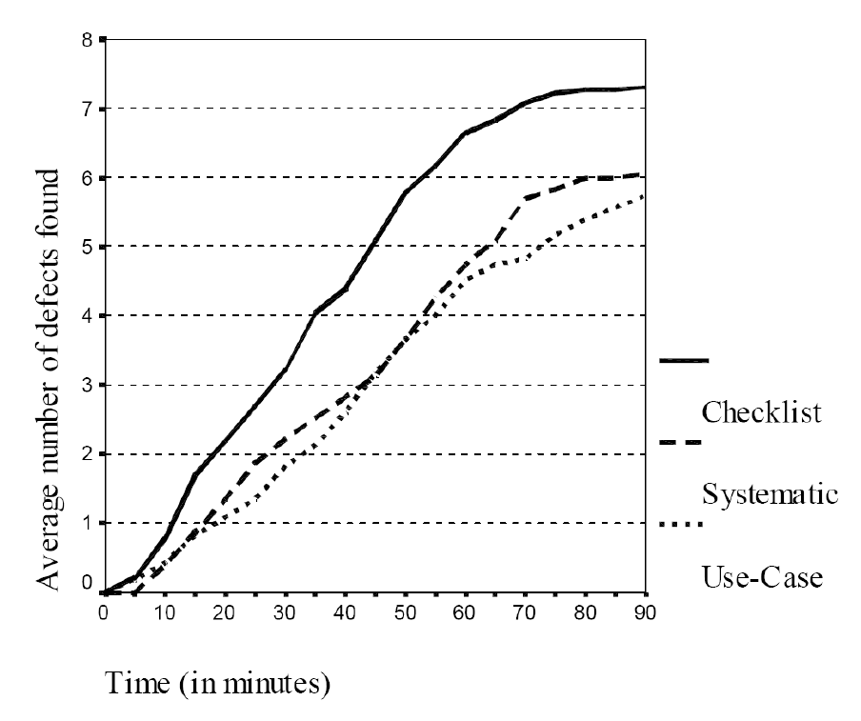
Code reviews? No problem
Dunsmore, Roper, Wood, 2000.
From Best-Kept Secrets of
Peer Code Review, Cohen, 2006
Notes:
Figure from Dunsmore, A., Roper, M., Wood, M. "Object-Oriented Inspection in the Face of Delocalisation", Proceedings of the 22nd International Conference on Software Engineering (ICSE) 2000 as quoted in Jason Cohen, "Best-Kept Secrets of Peer Code Review", 2006. Figure shows elapsed time versus cumulative number of defects found for each of the three types of review. The defect rate is constant until about 60 minutes into the inspection at which point it levels off with no defects found at all after 90 minutes.
In this figure, "checklist" reviewing involves the reviewer checking for a pre-listed series of common types of error. The "systematic" review is more specific about code points to inspect, with a view to potentially providing some automation for the review. The "use-case" review involves starting with information about how other code will be expected to call into the code under review: this is perhaps most similar to how a systematic review by someone else knowledgeable in the domain but not familiar with the code might proceed.

Slide 17
Unit testing: what is it?
A “unit test” is a bit of code that calls one of your functions, gives it some input, and tells you whether it returned the right result
Write a set of these, and you have a “test suite”
A “test framework” can help you write them more quickly; there's at least one for every programming language and environment
Should be set up so you can run all tests in one go

Slide 18
Unit testing: what's it for?
An automated way of ensuring:
That your code's API works
That you don't break your code when changing it
Also useful when developing a tricky algorithm (using test-first, or test-driven development)

Slide 19
Unit testing questions
“How can I test my code if I don't know what results to expect?”
Break it down into functions whose behaviour you can predict
Testable code is also more readable code anyway
Test individual components, not the whole thing
Unit testing is about trying to ensure that the code implements the method -- not that the method is the right one

Slide 20
Unit testing questions
“How can I test my code if I don't know what results to expect?”
  “... if we’ve learned anything from the agile movement in the last 15 years, it’s that the more improvisatory your development process is, the more important careful craftsmanship is as well—unless, of course, you don’t care whether your programs are producing correct answers or not.”
http://software-carpentry.org/2012/09/not-really-disjoint/

Slide 21
Unit testing questions
“What sort of test data and test cases should I write?”
The simplest possible ones!
“But I have big data sets and complex results!”
Don't use real-world data; that's a different kind of test
Look for the smallest possible input to test a given behaviour

Slide 22
Version control
Software to help keep track of changes made to files
Tracks the history of your work
Helps you collaborate with others
Popular examples include git, Mercurial, Subversion
Notes:
See also "Why use version control?" http://soundsoftware.ac.uk/why-version-control

Slide 23
Keeping track of history
How do you get back to that working version you had yesterday?
How do you get from "it's not working!" to understanding what went wrong?
How would you repeat the experiments from that journal paper you wrote last year?

Slide 24
Collaborating... with yourself!
You need to run the same software on your laptop at home and the server in the lab:
How do you get the code onto both?
How do you verify that you have the same code on both?
Notes:
The consistency guarantee (identifying versions, and identifying whether something has been changed from a given version and if so how) is the most powerful aspect here, and the one that distinguishes a version control system from a synchronisation and backup tool such as Dropbox.

Slide 25
Collaborating with others
You're working on code or a paper with a colleague...
How do you find out when they change something?
How do you merge your changes without getting in a mess?
How can you find out which of you introduced a bug, and when?

Slide 26
Version control helps with all this
A version control system
Records your files' history for you
Shows differences between different versions
Handles synchronisation between copies on different computers
But you do have to work a bit:
Tell it which files are part of your project
Tell it when you've changed something
If two people make conflicting changes, one of them has to resolve them

Slide 27
Version control systems
Subversion: Centralised
one server, one repository database
every commit goes straight to the shared repository
Mercurial, git: Distributed
every working copy has complete repository in it
commits are local, then push/pull between computers
e.g. work locally, then push to a remote hosting site

Slide 28
Version control hosting sites
General-purpose :
GitHub -- very popular for sharing Git repositories
BitBucket -- Git and Mercurial, good private repo support
SourceForge -- the grand dame of hosting sites
Specific:
code.soundsoftware.ac.uk -- for the UK audio and music research community
Very specific:
Does your department provide hosting?

Slide 29
How is that different from Dropbox?
Consistency:
  – Software needs to be exactly as written across all files
  – Files changed together must be updated together
  – Changes to a file by different people must be merged correctly
Record keeping:
  Publish and replicate history reliably
  Interrogate past changes

Slide 30
Managing work
When should I start using version control for my project?
Which files should I track in the repository?
How often should I commit?
How often should I push?

Slide 31
Five things to do tomorrow
Get your current research code into a version control repository, push to a hosting site
Pull it onto another computer, get it to build and run
Talk to another researcher in your group, allot an hour to experiment with reviewing a bit of each other's code
Identify a piece of your code that you can isolate and test
Pick a licence for your code, check compatibility with other code you're using, add it to code files
Notes:
A private project on a hosting site is fine!

