Slide 1
A Meta-analysis of High Resolution Audio Perceptual Evaluation
Josh Reiss, joshua.reiss@qmul.ac.uk
Centre for Digital Music
Queen Mary University of London

Slide 2
80 about high res audio perception
18 reviews or discussions
# publications
62 about evaluation experiments
11 involving non-hi-res experiments
51 about hi-res evaluation experiments
11 focused solely on perceptual resolution thresholds
40 about hi-res discrimination
7 focused solely on unusual delivery, response or stimuli
33 about hi-res perceptual discrimination
30 unique discrimination experiments
8 describing indirect discrimination,
2 comparing only hi-res formats
# experiments
21 direct discrimination
Contact authors, get unpublished data, transform data
17 with mean & SD per participant
1 with only overall mean
3 with insufficient reporting

Slide 3
The problem
  High resolution audio - recording, storing and rendering audio beyond standard CD quality, 44.1kHz / 16 bits
To what extent can we perceive high resolution audio?
  How do we test this?
  What do we already know?
  Why have some tests found a ‘Yes’, some a ‘No’
Meta-analysis - statistical analysis of a large collection of analysis results from individual studies
Widely used in evidence-based medical and social science research
More than literature review
More than secondary analysis

Slide 4
How the experiments were found
80 about high res audio perception
18 reviews or discussions
# publications
62 about evaluation experiments
Identified well-known papers
Iterative search of all citations within and all citations of those papers
Searches of other papers by all authors
Keyword searches in journal databases
11 involving non-hi-res experiments
51 about hi-res evaluation experiments
11 focused solely on perceptual resolution thresholds
40 about hi-res discrimination
7 focused solely on unusual delivery, response or stimuli
33 about hi-res perceptual discrimination
30 unique discrimination experiments
8 describing indirect discrimination,
2 comparing only hi-res formats
# experiments
21 direct discrimination
Contact authors, get unpublished data, transform data
17 with mean & SD per participant
1 with only overall mean
3 with insufficient reporting

Slide 5
Classification
Test type |  |  | Reference | Methodology
Auditory perception resolution | Bone conduction perception |  | Lenhardt 1991 | pattern recognition, frequency JND
 | Temporal resolution |  | Krumbholz 2003 | 2IFC
 |  |  | Kunchur 2007, 2008 | ABX
 | Frequency resolution |  | Ashihara 2004, 2006, 2008, 2010 | 2IFC
 | Joint time-frequency resolution |  | Oppenheim 2013, Majka 2015 | 2IFC
Format discrimination | Indirect discrimination | Brain response | Oohashi 1991, 2000; Yagi 2002, 2003 ; Fukushima 2014; Ashihara 2004, 2006, 2008, 2010 | N/A
 |  | Temporal resolution | Yoshikawa 1997 | Method of limits
 |  | Semantic description | Yagi 2002, 2003 ; Oohashi 1991, 2000 | DoD, Attribute rating
 |  | Other (level, spatialisation, live) | Hawksford 1997 ; King 2012 ; Yagi 2002, 2003 | Method of adjustment ; Multistimulus ranking
 | Sufficient formats discrimination | Alternative Hi-Res Formats | Blech 2004 | ABX
 |  |  | Marui 2014 | AB
 |  | Lo-res content | Woszczyk 2007 | AXY
 | High vs. non-high discrimination | Test signals | Ashihara 2000, 2001 2003 | 2IFC
 |  | Real world content | Oohashi 1991 ; Nishiguchi 2004, 2005, 2009 ; Meyer 2007; Kanetada 2013 ; Jackson 2014 | Same different
 |  |  | Theiss 1997, Pras 2010 | ABX
 |  |  | Yoshikawa 1995 ; Nishiguchi 2003, 2009 ; Woszczyk 2007 | AXY
 |  |  | Kanetada 2013, Mizumachi 2015 | XY

Slide 6
Secondary analysis - Hypotheses
Intermodulation distortion causes false positives (Ashihara)
high sample rate perceived with low resolution content (Woszczyk)
CD audio noise floor perceived at high listening levels (Meyer)
Order, choice and duration of intervals matter
  Oohashi: high frequency content remains in memory
  Theiss, Hamasaki : stronger results with long stimuli and/or long intervals
Distraction bias
  Theiss experiments performed in darkness (literally blind)
  Blech: stronger results with headphones
Abnormal test subjects
  Yoshikawa: Some individuals have far better discrimination
  Pras: some individuals anti-discriminate

Slide 7
Secondary analysis – Re-investigations
Multiple comparisons problem
  the more times an experiment is run, the more likely results appear significant by chance
  Yoshikawa 1995 are still significant but Hamasaki 2004 is not
Multiple comparisons anomaly
  Nishiguchi 2005 - no statistically significant results out of 54 (6 people times 3 comparisons times 3 samples)
  probability of only 6.27%
Invalidation of experiment
  Yagi 2003 - Stimuli played back at different listening levels for high and low resolution content

Slide 8
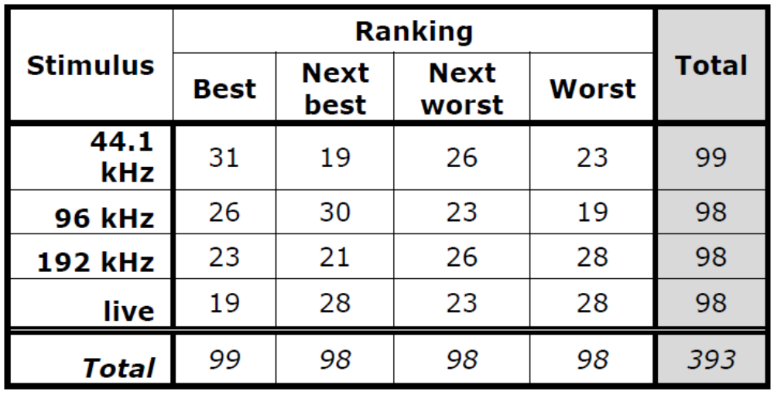
Secondary analysis – King 2012
Ranked 44.1, 96, 192 kHz and ‘live’ in terms of audio quality
“no significant findings or even trends”
Correlations suggest high sample
rate associated with ‘live’
  Live vs 44.1: -0.9449
  Live vs 96: -0.0986
  Live vs 192: 0.1476
chi-squared test
  Whole table: p=0.4145
  Grouping Best/Next best and Worst/Next worst: p=0.3977
  just best and worst, 441 and 192: p=0.2072
  just best and worst, 441 and live: p=0.0886

Slide 9
Secondary Analysis - Meyer and Moran 2007
Even if we believe their data, it does not appear random
  Only three subjects out of 55 had 7 or more out of 10 correct, p= 0.97%
  extremely low success rate for non-audiophiles, 30 out of 87
  audiophiles vs non-audiophiles gives p=0.18%
 |  | Correct | Incorrect | Total | P value | Chi² Statistic | P value
Total |  | 276 | 278 | 554 | 0.5507 | - | -
Gender | Male | 258 | 248 | 506 | 0.3446 | 3.1904 | 0.07407
 | Female | 18 | 30 | 48 | 0.9703
Hearing/Age | > 15 kHz / 14-25 years old | 116 | 140 | 256 | 0.9410 | 3.867 | 0.049245
 | ≤15kHz / 26 or more years old | 160 | 138 | 298 | 0.1119
Experience | Audiophile/ audio professional | 246 | 221 | 467 | 0.1334 | 9.7105 | 0.001832
 | Non-audiophile | 30 | 57 | 87 | 0.9988

Slide 10
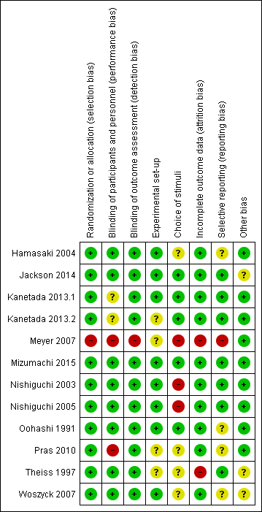
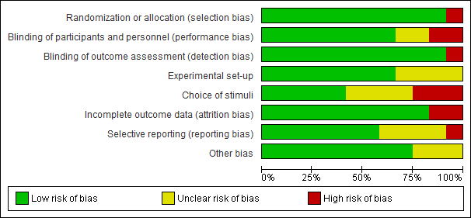
Issues in reported results
Publication bias
Type 1
  Selective reporting
  Undithered quantisers
  Intermodulation distortion
Type 2 errors
  Choice of stimuli
  Unaimed tweeters
  Multiple comparisons

Slide 11
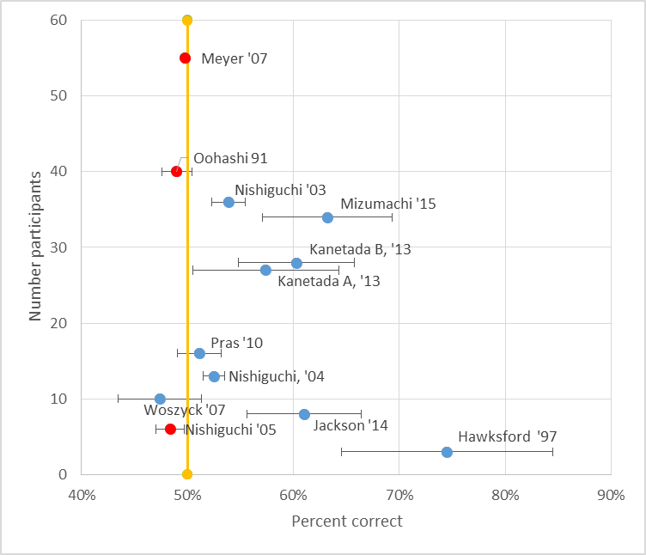
Meta-analysis- Overall
Direct discrimination of hi-res audio where average correct results available
# participants versus % correct results averaged over all participants
Error bars are +/-1 standard error of the mean
  For Meyer 2007, standard error cannot be found
Studies in red are those where results have been disputed

Slide 12
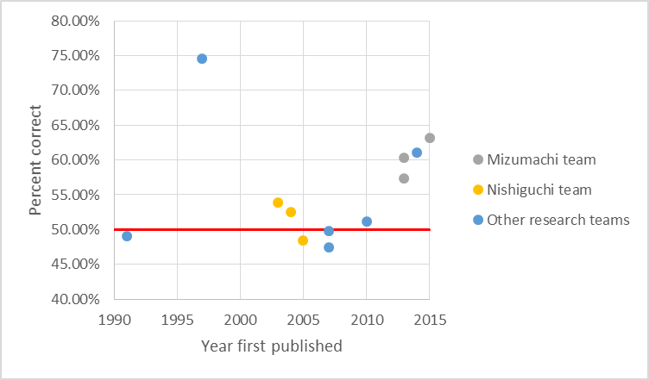
Meta-analysis – year and research team
Recent experiments have strong results
Mid-2000s have weak results
Research teams have consistent results
  Kanetada/Mizumachi use network attached audio, extensive group training
  Nishiguchi/Hamasaki don’t use training
  Both teams have large # test subjects

Slide 13
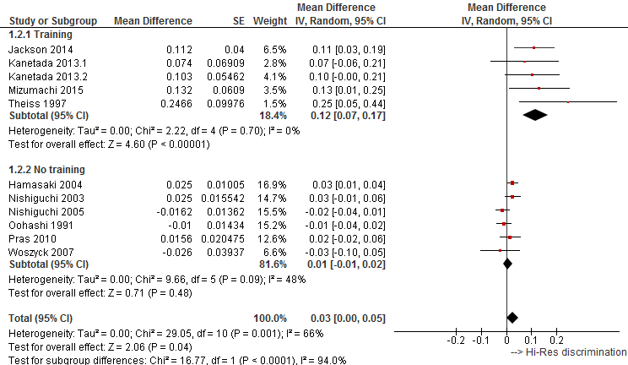
Meta-analysis – effect of training
Overall
Studies are heterogeneous
Slight but statistically significant ability to detect hi-res
Studies without training
Heterogeneous
Small and not significant discrimination of hi-res
Studies with training
Homogenous (!)
Strong, highly significant ability to discriminate hi-res
Subgroup differences
Huge
Could be due to other reasons besides training
Notes:
Figure 2. A forest plot of studies where mean and standard deviation can be obtained, divided into subgroups based on whether participants were trained.
The statistic I² measures the extent of inconsistency among the studies’ results, and is interpreted as approximately the proportion of total variation in study estimates that is due to heterogeneity rather than sampling error. Similarly, a low P value for heterogeneity suggests that the tests differ significantly, which may be due to bias. This suggests a strong consistency between those studies with training, and these studies generally found a strong effect. In contrast, those studies without training had large differences, which cannot be attributed solely to statistical variation. Contrasting the subgroups, the test for subgroup differences gives I² of 94%. This measures the extent of inconsistency across the subgroups’ results, and is interpreted as approximately the proportion of total variation in subgroup estimates that is due to genuine variation across subgroups rather than sampling error.

Slide 14
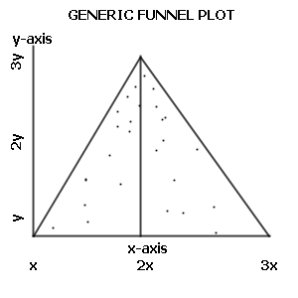
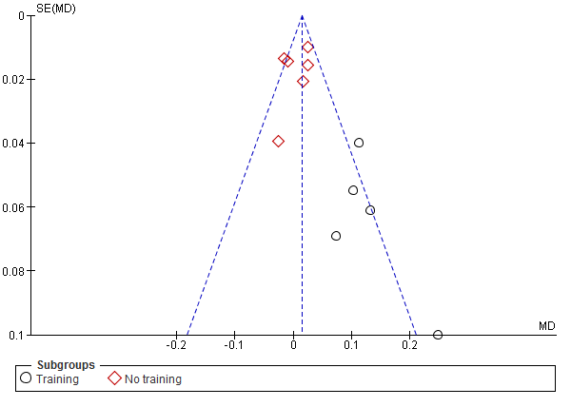
Funnel plot and effect of training
Ideal funnel plot
Asymmetric funnel plot
All experiments with training had large standard error
  Small number of participants, or
  Small number of trials per participant
suggestive of bias
  If you do a large experiment, you publish
  If you do a small one with a big result, you publish
  If you do a small experiment with a null result, you don’t publish

Slide 15
Meta-analysis – Stimuli and interval duration
Longer
Shorter
Analysis ongoing, but;
  Kanetada 2013A, Kanetada 2013B, Mizumachi 2015 all had strong results with 120s samples
  Hamasaki - stronger results with longer samples (85-120s vs 20s)
  Theiss and Hawksford - strong results with 30s intervals requiring auditory memory
  Yoshikawa - strong result with 20s samples
  Oohashi’s – weak results (persistence effect) with 12s samples, 3s intervals
  Jackson - strong result with short samples (~11.9s)
  Pras - weak results with short samples (8-10s)
  → likelihood that analysis suggests longer stimuli and interval durations

Slide 16
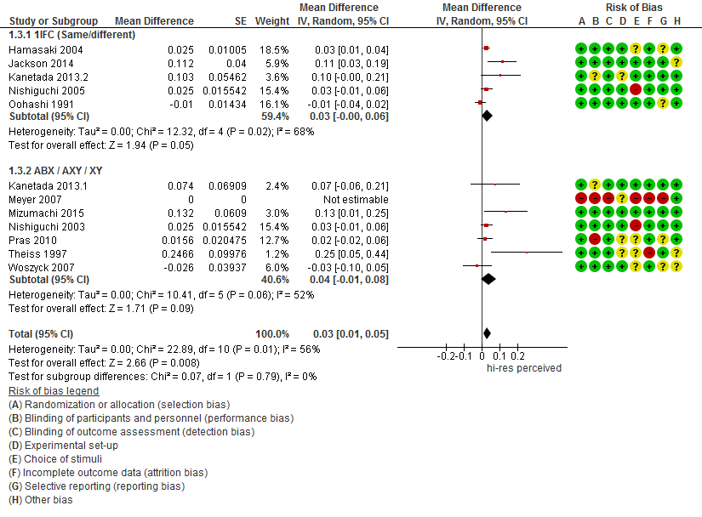
Meta-analysis – Dependence on methodology
No effect found

Slide 17
Meta-analysis – ‘golden ears’
Histogram of all reported p values
  8 studies, 146 participants
Uniform distribution → no effect
More below 0.5 → overall effect
Bump at low p values → golden ears
No strong evidence of this

Slide 18
Summary
Meta-analysis suggests high resolution audio can be perceived
Listening tests require careful design
  Extensive training of participants
  Careful choice of stimuli
  Sufficiently long durations
Strong need for reproduction of an experiment by independent group
More data needed
  Deeper analysis of dependence on stimuli, durations, ordering, quantization
Meta-analysis of indirect discrimination experiments needed

Slide 19
Meta-analysis – Does choice of ‘sufficient formats’ matter?
Analysis ongoing, but;
Discrimination between high resolution formats
  Blech 2004 – no effect
  Marui 2014 – significant effect
Discrimination of high sampling rate with filtered content below 20kHz
  Woszczyk 2007 – strong effect
  Nishiguchi 2005 – no effect

Slide 20
Meta-analysis – Effect of quantization
Few studies on perception of dither and quantization
  Kvist 2005 showed preference for dither only at low bit rates!
  Mortberg 2007 found discrimination of quantization very challenging, and discrimination of dither even harder
Analysis ongoing, but;
Kanetada 2013.2 – Strong 16/24 bit discrimination
  Was it dithered?
Theiss 1997 – Stronger result with 24 bit quantization
  Only 3 participants
Jackson 2014 – mixed. Slightly better results with 24 bit quantization?
…

