Slide 1


Deep Learning Applied to SATB Choirs
Pritish Chandna¹, Helena Cuesta¹, Darius Petermann¹, Emilia Gómez^{2,1}
¹ Music Technology Group, Universitat Pompeu Fabra, Barcelona, Spain
² Joint Research Centre, European Commission, Seville, Spain

Slide 2
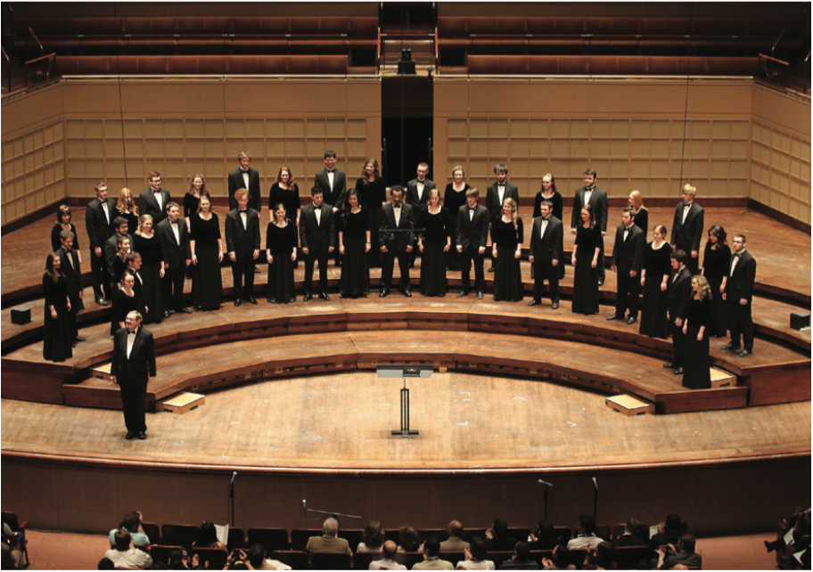

SATB Choirs
Soprano, Alto, Tenor and Bass choirs
Four voices with distinct pitch range [1]
  "Soprano" (260 Hz-880 Hz)
  "Alto" (190 Hz-660 Hz)
  "Tenor" (145 Hz-440 Hz)
  "Bass" (90 Hz-290 Hz)
Important cultural element but understudied in MIR
[1] M. Scirea and J. A. Brown, “Evolving four part harmony using a multiple worlds model,” in Proceedings of the 7th International Joint Conference on Computational Intelligence (IJCCI), vol. 1. IEEE, 2015, pp. 220–227.
1

Slide 3
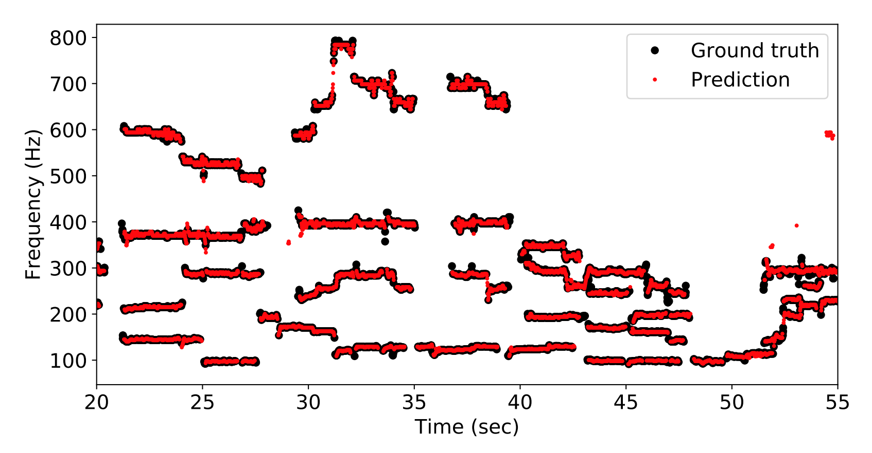
Deep Learning Applied to SATB Choirs at ISMIR 2020
Source Separation [1]
MultiF0 Estimation [2]
Unison analysis and synthesis [3]
?
Choral Mixture
[1] D. Petermann, P. Chandna, H. Cuesta, J. Bonada, and E. Gómez, “Deep learning based source separation applied to choir ensembles,”
[2] H. Cuesta, B. McFee, and E. Gómez, “Multiple F0 Es-timation in Vocal Ensembles using Convolutional Neu-ral Networks,”
[3] P. Chandna, H. Cuesta, and E. Gómez, “A deep learning based analysis-synthesis framework for unison singing,”
2

Slide 4
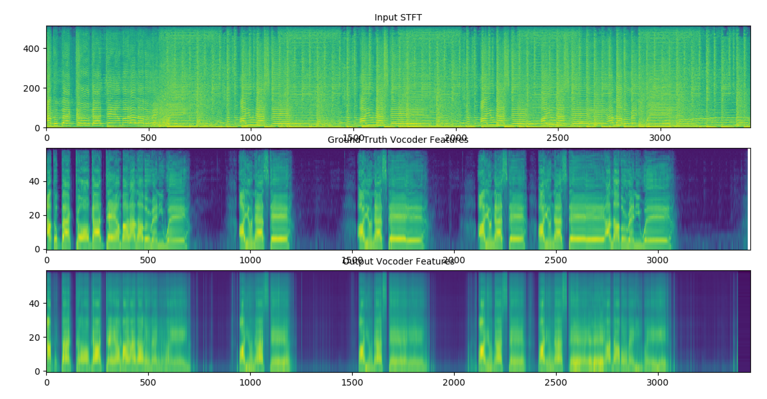
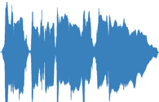
Analyzing the Voice Through Vocoders – Voice Encoders
Lower Dimension Encoding
Resynthesized Voice Signal
Voice Signal
Encoder
Decoder
Signal processing vocoder encoders using filterbanks to represent spectral characteristics of the voice signal.
Decoders consist of carrier signal (or noise for unvoiced sibilant sounds like s, f) and modulator modelling the formants.
WORLD [1]
Deep learning based vocoders (autoregressive and feedforward, GAN based) have been proposed for speech. [2] Inverting Mel-Spectrogram to waveform.
[1] M. Morise, et, al “World: a vocoder-based high-quality speech synthesis system for real-time applications ,”IEICE TRANSACTIONS on Information and Systems, vol. 99, no. 7, pp. 1877–1884, 2016.
[2] J. Shen et al., "Natural TTS Synthesis by Conditioning Wavenet on MEL Spectrogram Predictions," 2018 IEEE International Conference on Acoustics, Speech and Signal Processing (ICASSP), Calgary, AB, 2018, pp. 4779-4783, doi: 10.1109/ICASSP.2018.8461368.
3

Slide 5
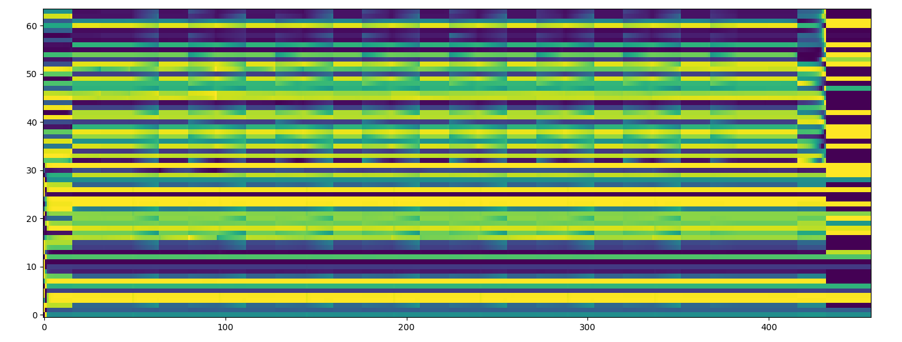
Voice Conversion (VC) Systems For Speech
Vocoder Features (Mel-Spectrogram)
Singer Independent Representation of Content
Vocoder Features (Mel-Spectrogram)
Encoder
Decoder
Singer Identity
Speech Conversion [1]
Speech Conversion Applied to Singing Voice [1]
Original
Converted
Original
Converted
1) Kaizhi Qian, Yang Zhang, Shiyu Chang, Xuesong Yang, andMark Hasegawa-Johnson,“Autovc: Zero-shot voice style transfer with only autoencoder loss,” in International Conference on Machine Learning, 2019,
2) Wu, Da-Yi, Yen-Hao Chen, and Hung-Yi Lee. "VQVC+: One-Shot Voice Conversion by Vector Quantization and U-Net architecture
3) Kaneko, T. & Kameoka, H. Parallel-data-free voice conversion using cycle-consistent adversarial networks (2017)
4) Kameoka, H., Kaneko, T., Tanaka, K. & Hojo, N. Stargan-vc: non-parallelmany-to-many voice conversion using star generative adversarial networks.2018IEEE Spoken Language Technology Workshop (SLT)(2018)
4

Slide 6
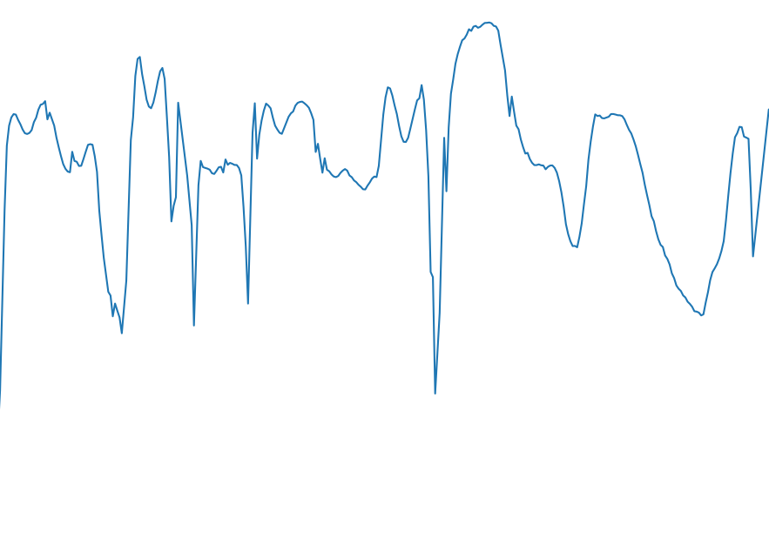
Voice Conversion (VC) Systems For Singing Voice (Disentangle F0)
Mixture Spectrogram (Magnitude)
Singer Independent Representation of Content
Spectral Envelope [2]
Encoder
Decoder
Singer Identity
F0
Disentangled F0 Conversion [1]
Original
Converted
1) Kaizhi Qian, Yang Zhang, Shiyu Chang, Xuesong Yang, andMark Hasegawa-Johnson,“Autovc: Zero-shot voice style transfer with only autoencoder loss,” in International Conference on Machine Learning, 2019,
2) Singing Voice Conversionwith Disentangled Representations of Singer and Vocal Technique Using Vari-ational Autoencoders 2–6 (2019)
3) Deng, C., Yu, C., Lu, H., Weng, C. & Yu, D. PitchNet: Unsupervised SingingVoice Conversion with Pitch Adversarial Network (2019).
4) Sisman, B., Vijayan, K. & Dong, M. SINGAN : Singing Voice Conversion withGenerative Adversarial Networks 112–118
5

Slide 7
Using VC Features For Singing Voice Extraction From Polyphonic Mixture
Singer Independent Continuous Representation of Linguistic Features [1]
Mixture Spectrogram (Magnitude)
Spectral Envelope [2]
Encoder
Decoder
Singer Identity (One hot or learned)
Polyphonic F0 extraction [3]
1) Kaizhi Qian, Yang Zhang, Shiyu Chang, Xuesong Yang, andMark Hasegawa-Johnson,“Autovc: Zero-shot voice style transfer with only autoencoder loss,” in International Conference on Machine Learning, 2019,
2) Masanori Morise, Fumiya Yokomori, and Kenji Ozawa,“World: a vocoder-based high-quality speech synthesis system for real-time applications,” in IEICE TRANSACTIONS on Information and Systems, vol. 99,
3) Andreas Jansson, Rachel M Bittner, Sebastian Ewert, and Till-man Weyde, “Joint singing voice separation and f0 estimation with deep u-net architectures,”
6

Slide 8
Why Are You Using A Signal Processing Based Vocoder? I’ve Heard Deep Learning IS THE SOTA. Get With The Times And Use Deep Learning Or Get Out Of Here
The proposed architecture is agnostic to the exact vocoder features used.
Disentangle F0 and Timbre
Faster and more resource efficient than Autoregressive Vocoders
Deep Learning Based Vocoders are not easily adaptable to Singing Voice
  Rapidly evolving field
  Research done by colleague – Merlijn Blaauw
  Blaauw, Merlijn, and Jordi Bonada. "Sequence-to-sequence singing synthesis using the feed-forward transformer." ICASSP 2020-2020 IEEE International Conference on Acoustics, Speech and Signal Processing (ICASSP). IEEE, 2020.
7

Slide 9
Fine, we’ll let it rest for now, finish your presentation
AutoVC [1] suggests that an autoencoder which has a sufficiently small bottleneck can learn to disentangle content from the speaker identity.
1) Kaizhi Qian, Yang Zhang, Shiyu Chang, Xuesong Yang, and Mark Hasegawa-Johnson,“Autovc: Zero-shot voice style transfer with only autoencoder loss,” in International Conference on Machine Learning, 2019
8

Slide 10
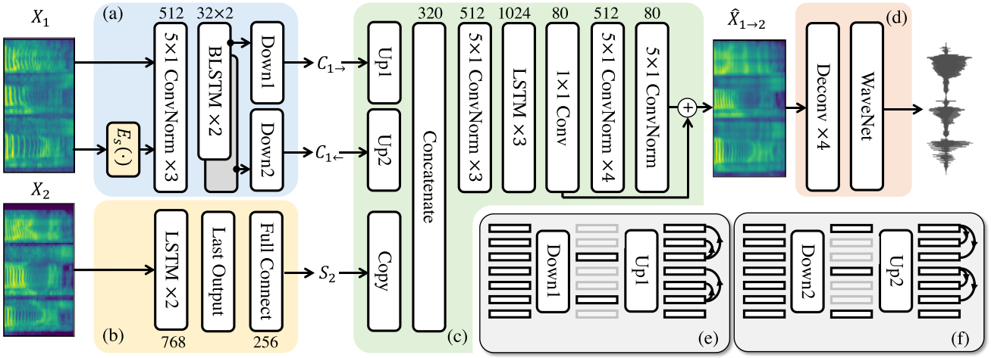
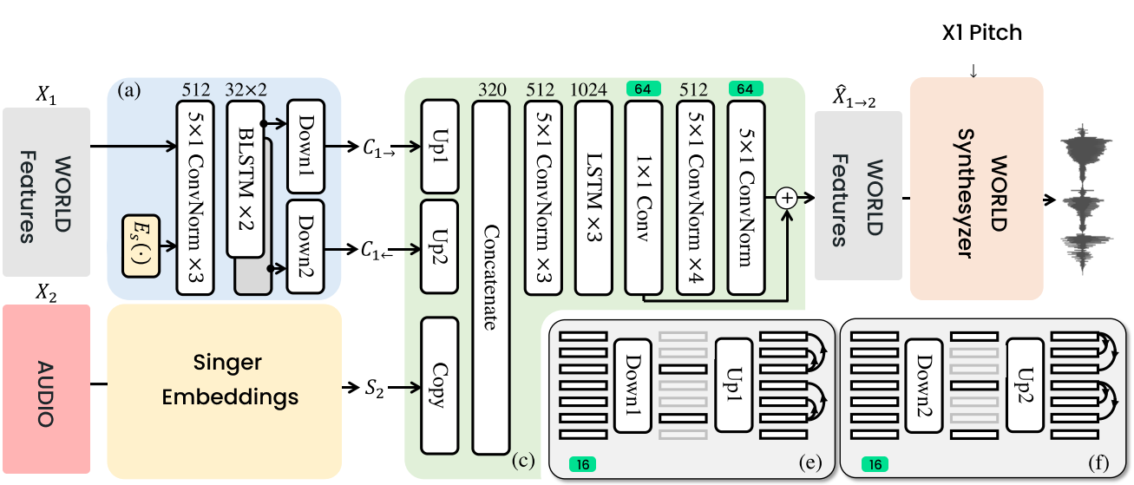
Adapting The AutoVC Architecture
We use truncated frequency warping in the cepstral domain to reduce the dimensions of the harmonic components from 11024 to 60 log Mel-Frequency Spectral Coefficients (MFSCs) with an all-pole filter with warping coefficient alpha=0.45$.
In addition, we use bandwise aperiodic analysis to reduce the dimensionality of aperiodic features to 4. Resulting in a total of 64 spectral features
9

Slide 11
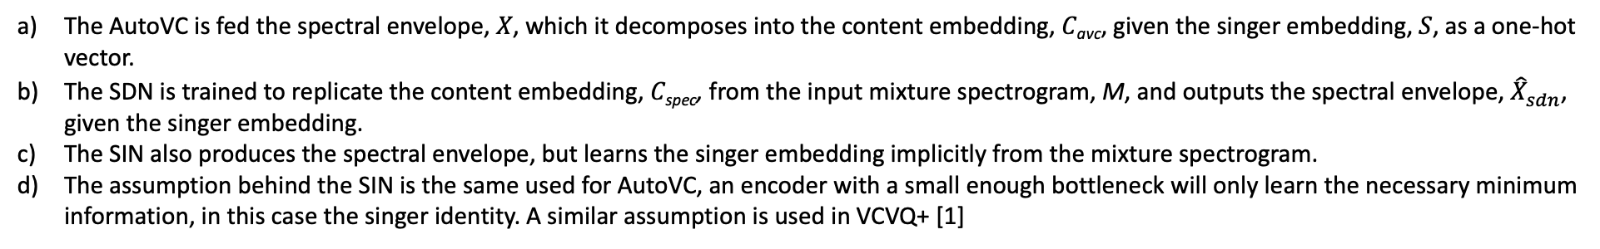
Training The AutoVC For Vocal Extraction
As shown in the figure on the left, we use three networks for training, the AutoVC, the Singer Dependent Model (SDN) and the Singer Independent Model (SIN).
We use a proprietary dataset, provided by Yamaha Corporation for training. The training set consists of 205 songs by 45 distinct male and female singers, with a total of around 12 hours of data. The songs are mostly pop songs in the English and Japanese languages.
The AutoVC is fed the spectral envelope, 𝑋, which it decomposes into the content embedding, 𝐶_{avc}, given the singer embedding, 𝑆, as a one-hot vector.
The SDN is trained to replicate the content embedding, 𝐶_{spec}, from the input mixture spectrogram, M, and outputs the spectral envelope, ${\hat{X}}_{sdn}^{}$, given the singer embedding.
The SIN also produces the spectral envelope, but learns the singer embedding implicitly from the mixture spectrogram.
The assumption behind the SIN is the same used for AutoVC, an encoder with a small enough bottleneck will only learn the necessary minimum information, in this case the singer identity. A similar assumption is used in VCVQ+ [1]
1) Wu, Da-Yi, Yen-Hao Chen, and Hung-Yi Lee. "VQVC+: One-Shot Voice Conversion by Vector Quantization and U-Net architecture."
10

Slide 12
Why Do All This? Source Separation Is Already Solved
While most recently proposed source separation algorithms [1,2,3,4] focus on extracting the vocal stem, our proposed algorithm builds on our previous proposal [5] and attempts to resynthesize the underlying raw vocal track based on a continuous representation of the linguistic content present in the input mixture
1) Andreas Jansson, Eric Humphrey, Nicola Montecchio, Rachel Bittner, Aparna Kumar, and Tillman Weyde, “Singing voice separation with deep u-net convolutional networks,” 2017
2) Daniel Stoller, Sebastian Ewert, and Simon Dixon, “Wave-u-net: A multi-scale neural network for end-to-end audio source separation,” 2018
3) Aditya Arie Nugraha, Antoine Liutkus, and Emmanuel Vin-cent, “Multichannel music separation with deep neural net-works,” in2016 24th European Signal Processing Conference(EUSIPCO). IEEE, 2016
4) Chandna, Pritish, et al. "Monoaural audio source separation using deep convolutional neural networks." International conference on latent variable analysis and signal separation. Springer, Cham, 2017
5) Pritish Chandna, Merlijn Blaauw, Jordi Bonada, and Emilia Gomez, “A vocoder based method for singing voice extraction,” in ICASSP 2019-2019
11

Slide 13
Datasets
Require clean multi-singer unprocessed vocals, with backing track.
Public datasets which meet this requirement
  MedleyDB – Too small for training, but we used for testing, showing robustness of our model.
  MUSDB – most commonly used for source separation but does not have clean vocal track.
  DAMP, we tried to use, but it was not clean or homogenous enough, since the recordings are through phone microphones.
  NUS, too small and does
We use a proprietary dataset, provided by Yamaha Corporation for training.
  The training set consists of 205 songs by 45 distinct male and female singers.
  Total of around 12 hours of data.
  The songs are mostly pop songs in the English and Japanese languages.
11

Slide 14
Applications
We present a methodology to extract the raw unprocessed vocal signal from a musical mixture based on a linguistic feature extractor.
Applications include
Removing effects from vocal stems
Synthesizing a single voice from unison
Converting growling vocals to clean singing voice
Transcription
Voice change
Pitch correction
Re-mixing.
Audio examples are available at https://pc2752.github.io/sep_content/
Code for the model is available at https://github.com/MTG/content_choral_separation
All examples shown in this presentation are real-world examples, wherein the input singers (and in some cases, the language) were not seen by the model during training.
The TITANX used for this research was donated by the NVIDIA Corporation. This work is partially supported by the Towards Richer Online Music Public-domain Archives (TROMPA H2020 770376) project. The dataset used for training was provided by Yamaha Corporation
12

Slide 15





Unison Singing
Multiple simultaneous singers
Same melodic and linguistic content
Timing and pitch deviation
Single pitch perceived [1]`
[1] S. Ternström, “Perceptual evaluations of voice scatter in unison choir sounds,”STL-Quarterly Progress and Status Report, vol. 32,
13

Slide 16
Back To Unison Analysis
Leverage recent advancements in Deep Learning technologies for analyzing and emulating unison singing in the context of SATB choirs.
Real World Dataset
Analyze
Synthesize
Choral Singing Dataset [2]
3 pieces in 3 languages
4 parts
4 singers in unison per part
Manually corrected F0 annotations
Monophonic F0 extractor representing perceived pitch of unison [3]
Compare to individual F0 curves and mean of all curves
Inter-singer F0 deviations
Inter-singer timing deviations
Unison from A Capella (UTS)
A Capella from Unison (STU)
  Maintain linguistic content
  Single pitch.
Recently proposed methodology for singer independent vocal extraction [4]
[2] H. Cuesta, E. Gómez, A. Martorell, and F. Loáiciga, “Analysis of intonation in unison choir singing,” in Proceedings of the International Conference of Music Perception and Cognition (ICMPC), 2018
[3] J. W. Kim, J. Salamon, P. Li, and J. P. Bello, “Crepe:A convolutional representation for pitch estimation,” in Proceedings of the IEEE International Conference on Acoustics, Speech and Signal Processing (ICASSP),Calgary, Canada, 2018
[4] P. Chandna, M. Blaauw, J. Bonada, and E. Gómez,“Content based singing voice extraction from a musical mixture,” inProceedings of the 45th IEEE International Conference on Acoustics, Speech, and Signal Processing (ICASSP). IEEE, 2020
14

Slide 17
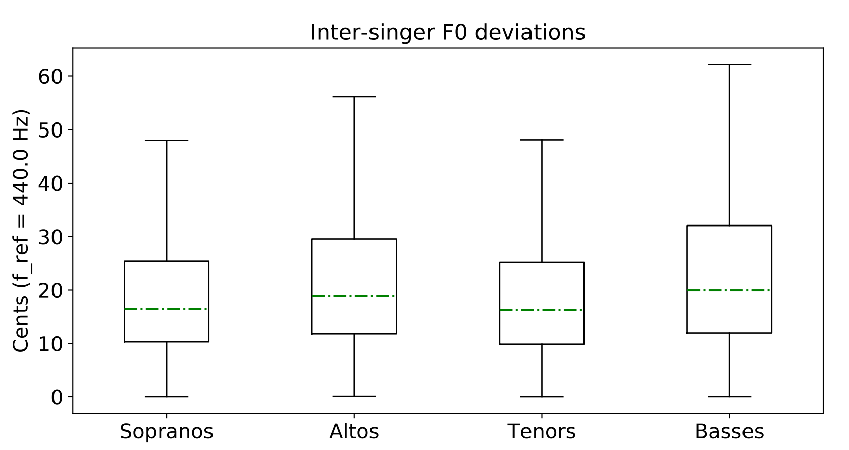
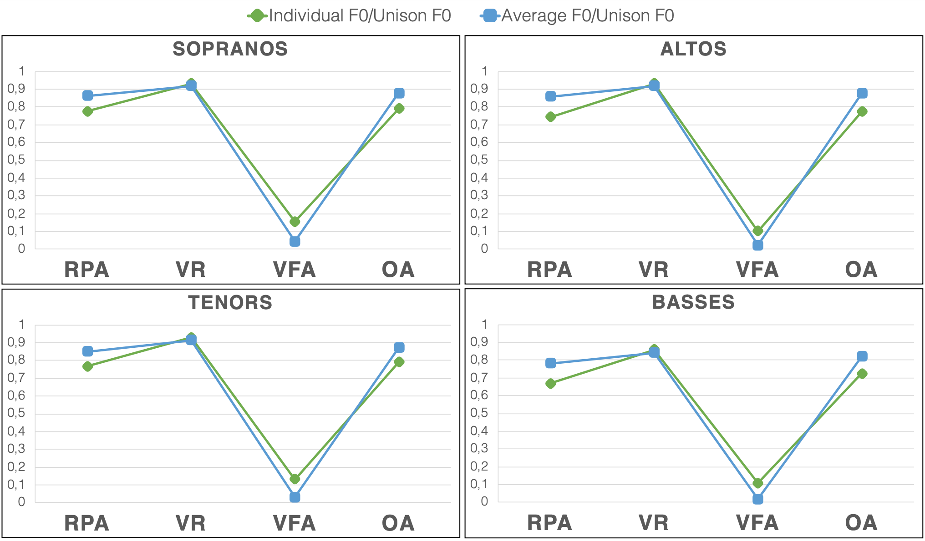
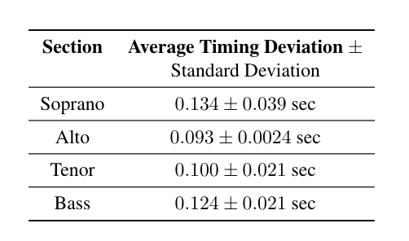
Resemblance of estimated pitch (CREPE) to the individual F0 tracks and the average
F0 extracted by CREPE is closer to the average F0 of all singers in the unison and thus can be used as a representation of the perceived pitch.
15

Slide 18
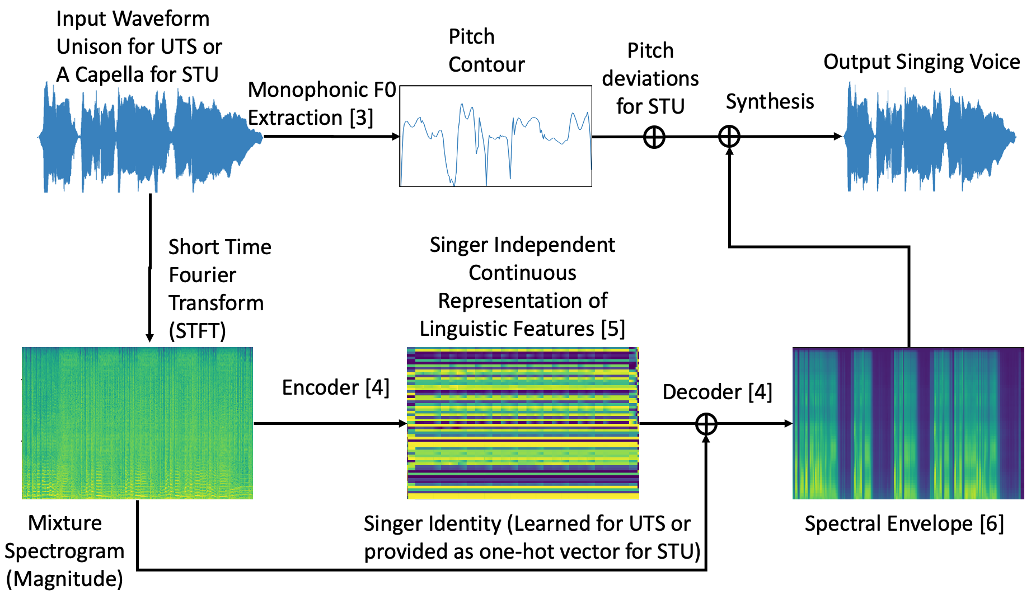
[3] J. W. Kim, et. al, “Crepe:A convolutional representation for pitch estimation,” in Proceedings of the IEEE International Conference on Acoustics, Speech and Signal Processing (ICASSP),Calgary, Canada, 2018
[4] P. Chandna. et al. ,“Content based singing voice extraction from a musical mixture,” inProceedings of the 45th IEEE International Conference on Acoustics, Speech, and Signal Processing (ICASSP). IEEE, 2020
[5] K. Qian, et.al andM. Hasegawa-Johnson, “Autovc: Zero-shot voice style transfer with only autoencoder loss,” in International Conference on Machine Learning, 2019
[6] M. Morise, et, al “World: avocoder-based high-quality speech synthesis systemfor real-time applications,”IEICE TRANSACTIONS on Information and Systems, vol. 99, no. 7, pp. 1877–1884, 2016.
16

Slide 19
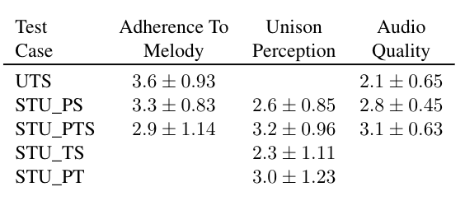
Conclusions
Adherence to melody
  F0 extracted by CREPE represents the single perceived pitch of the unison.
Pitch and timing deviations are necessary for the perception of unison, but singer variations are not perceived
Audio quality can be improved.
Examples at: https://pc2752.github.io/unison_analysis_synthesis_examples/
Source code available at: https://github.com/MTG/content_choral_separation
Applications such as creating a unison choral effect to be used in music production as well as for transposition and transcription.
16

