Slide 1
SoundSoftware.ac.uk Prizes for
Reproducibility
in Audio & Music Research
Chris Cannam, Luís Figueira, Mark Plumbley
Centre for Digital Music
Queen Mary, University of London

Slide 2
About us
The SoundSoftware project (soundsoftware.ac.uk)
EPSRC-funded
Smaller sibling to the Software Sustainability Institute
“Embedded” in the audio & music research field
Based at Queen Mary, University of London

Slide 3
The problem
A familiar one:
Audio and music researchers almost all develop software during their work
Yet many papers still lack the accompanying code and data
We refer to “reproducibility”; transparency and replicability would be a good start

Slide 4
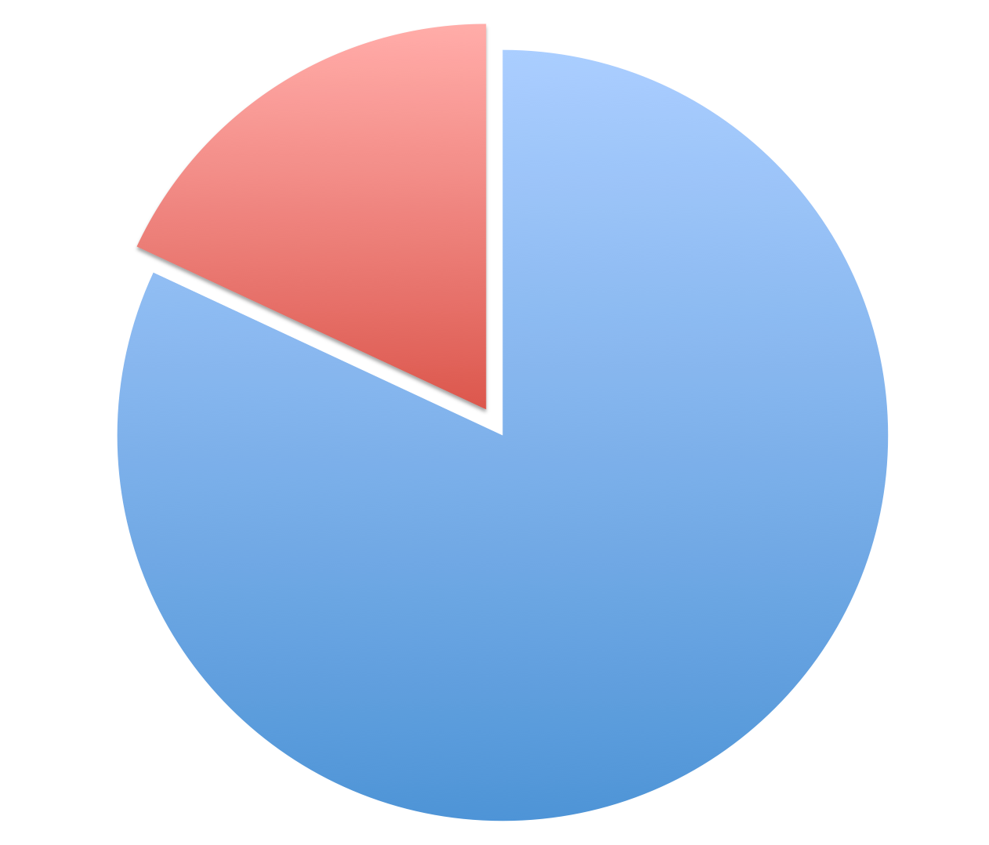
Survey 2010–2011
82% develop code
Notes:
Our survey of UK audio and music researchers ran from Oct 2010 – April 2011.
We had 54 complete and 23 partial responses.
82% of respondents said they developed code during their research work.
See http://code.soundsoftware.ac.uk/documents/17 for the survey report.

Slide 5
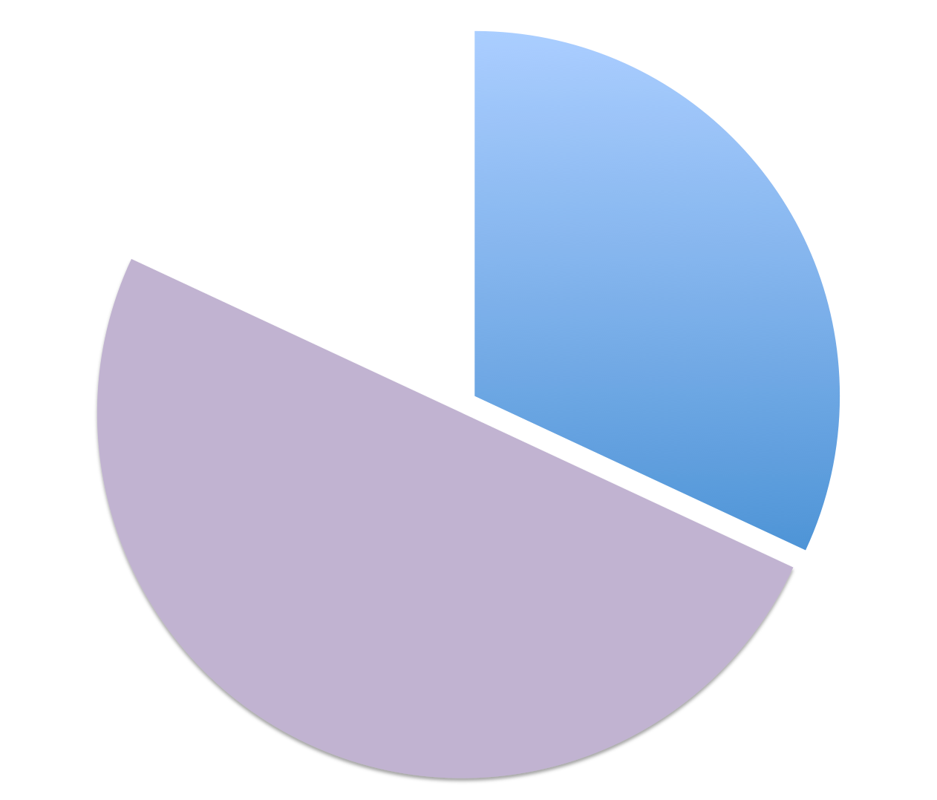
Survey 2010–2011
of whom 39% report taking steps to reproducibility
Notes:
Of those, 39% reported having taken some steps toward reproducibility of their work.
Apart from publishing code and data, examples included: using standard, publicly-available datasets and calibration procedures, and documenting code and data so that researchers in the same group could reproduce the results later.

Slide 6
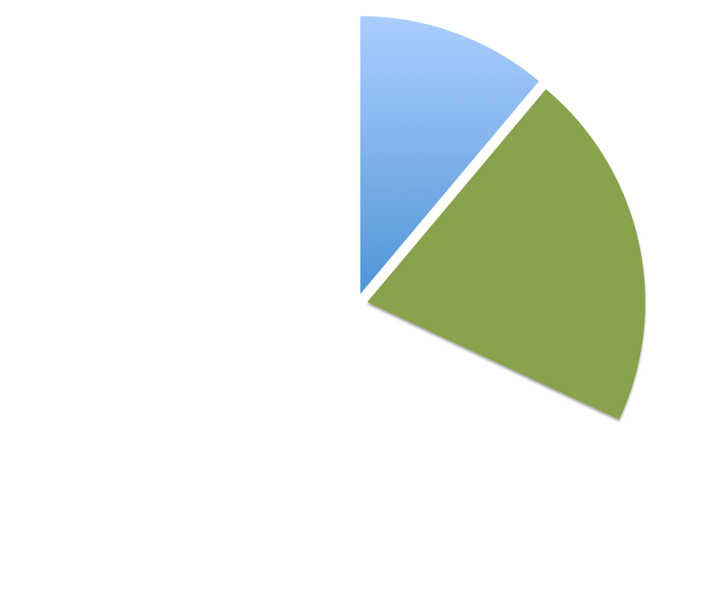
Survey 2010–2011
of whom 35% report publishing any code
Notes:
Of the respondents reporting taking steps to reproducibility, 35% reported actually having published any code.

Slide 7
Survey 2010–2011
That's 11% of the whole
Notes:
That's 11% of the whole, or 14% of the respondents who reported developing code.
Respondents also reported using a wide variety of frameworks, languages and technologies.
These included MATLAB and numerous toolboxes, Max/MSP, C++ and OpenFrameworks, Juce, HTK and MPTK, SuperCollider, Python, and Clojure.

Slide 8
Barriers to publication and reuse
Lack of education and confidence with code
Lack of facilities and tools
Platform incompatibilities
Lack of incentive for publication
Notes:
These are barriers to publication and reuse of code, rather than of data sets.

Slide 9
RR Prizes: Motivation
Promote development and release of sustainable and reusable software associated with published research
Recognise researchers who take the extra step, or whose work which will enable others to do so
Offer a really clear short-term incentive

Slide 10
RR Prizes: What we did (and why)
Broad call for submissions: journal or conference papers, published or pending
Very little idea what response we might get
“If you have published your software or datasets as part of your audio or music research output, so that other UK researchers can reproduce your results, you could win a prize!”

Slide 11
RR Prizes: Categories and prizes
Journal paper: New submission
Conference paper: New submission
Journal paper: Already published
Conference paper: Already published
Prizes: Article Processing Charge for open access publication; travel bursaries; other options

Slide 12
RR Prizes: Categories and prizes
Journal paper: New submission – one entry!
Conference paper: New submission – 3 entries
Journal paper: Already published – 3 entries
Conference paper: Already published – 5 entries
13 entries total (7 from UK) across 10 institutions
5 MATLAB; 3 C/C++; 2 Python; 1 Lisp
Two with no software (datasets only)

Slide 13
RR Prizes: Work and meta-work
Five traditional research papers
Two papers presenting “challenges”
Two presenting software applications
Two reviewing reproducibility of other work
One presenting a newly-compiled test dataset
One presenting a data interchange format

Slide 14
RR Prizes: Judging criteria
– Ease of reproducibility of the results
→ assessed by SoundSoftware (that’s us)
– Quality of sustainability planning
→ assessed by the Software Sustainability Institute
– Potential to enable high quality research in the UK audio and music research community
→ assessed by external reviewers

Slide 15
How reproducible were they?
Somewhat… with a number of fiddly details!
Hard-coded paths for dependency files and scripts (/home/myname/test1/data.csv)
MATLAB version incompatibilities, missing Python modules
Public datasets gone missing
Randomised test datasets, random matrix initialisers, etc
Good practices:
Publishing via e.g. github or our own code site (5 submissions)
Script to test the environment is set up correctly (1 submission)
Scripts as used when assembling the actual paper!

Slide 16
Prize winners
Majdak, P., et al, Spatially Oriented Format for Acoustics: A Data Exchange Format Representing Head-Related Transfer Functions
Sturm, B. L., et al, Comments on “Automatic Classification of Musical Genres Using Inter-Genre Similarity” – and two other papers
Giannoulis, D., et al, A Database and Challenge for Acoustic Scene Classification and Event Detection
Raffel, C., and Ellis, D., Reproducing Pitch Experiments in “Measuring the Evolution of Contemporary Western Popular Music”

Slide 17
Next round
Tie-in with Audio Engineering Society 53rd Conference, on Semantic Audio (London, January 2014)
Prize submission deadlines coordinated with the AES
Hints for reproducible publication available before conference deadline
Try to encourage people to think about this as they prepare their submissions

Slide 18
What we’ll do differently
Separate “reproducible” papers from “enabling” ones
All four prizes, and one of our two honourable mentions, went to “enabling” papers or meta-papers
More upfront hints about how to test your work
Use a virtual machine image
Check documentation etc (SSI checklist)
Ask a friend to try it!

Slide 19
Many thanks
To the sustainability panel of the Software Sustainability Institute:
Tim Parkinson, Arno Proeme, Neil Chue Hong

Slide 20
See our site for more information about the prizes!
– http://soundsoftware.ac.uk/rr-prize
Questions…?
Notes:
Other links:
Sound Software: Towards Software Reuse in Audio and Music Research – our paper from ICASSP 2012 expanding on the motivation
http://soundsoftware.ac.uk/icassp-2012-paper
Open source software licences explained
http://soundsoftware.ac.uk/open-source-software-licences-explained
Version control: What system to use?
http://soundsoftware.ac.uk/version-control-what-system-to-use
How to get started with our code site
http://soundsoftware.ac.uk/getting-started-soundsoftware-code-site
Why might I want to use code.soundsoftware.ac.uk?
http://code.soundsoftware.ac.uk/projects/soundsoftware-site/wiki/Why

