Slide 1
Pointers to more effective software & data in audio research
Mark D Plumbley, Chris Cannam, Steve Welburn
Centre for Digital Music
Queen Mary, University of London
Notes:
(This presentation has notes)

Slide 2
Research software: The Question
“How do you know your code implements your method at all?”

Slide 3
Validation and verification
Validation: Establishing how well your model represents reality
Research papers are expected to do this

Slide 4
Validation and verification
Validation: Establishing how well your model represents reality
Research papers are expected to do this
Verification: Establishing that you have implemented your model
This is what formal software testing is about
It's also what most informal good practice aims at
Research papers seldom attempt any of this

Slide 5
“Feedback cycles”
Write code → learn how code is wrong → fix code
Software development “best practice” is often about trying to shorten or simplify this cycle
Learn about your mistakes as early as possible
Notes:
For commercial software projects, “The data on the percentage of time spent in error removal has varied over the years, but the usual figures are 20-20-20-40. That is, 20 percent for requirements, 20 percent for design, 20 percent for coding (intuition suggests to most programmers that here is where the time is spent, but intuition is very wrong), and 40 percent for error removal”. Quoted in Robert L. Glass, “Facts and Fallacies of Software Engineering”, 2003, from “Building Quality Software”, 1992, by the same author.

Slide 6
Notes:
A series of illustrations of the ways in which we get feedback about what is wrong with our software.
Here I am, with my software…

Slide 7
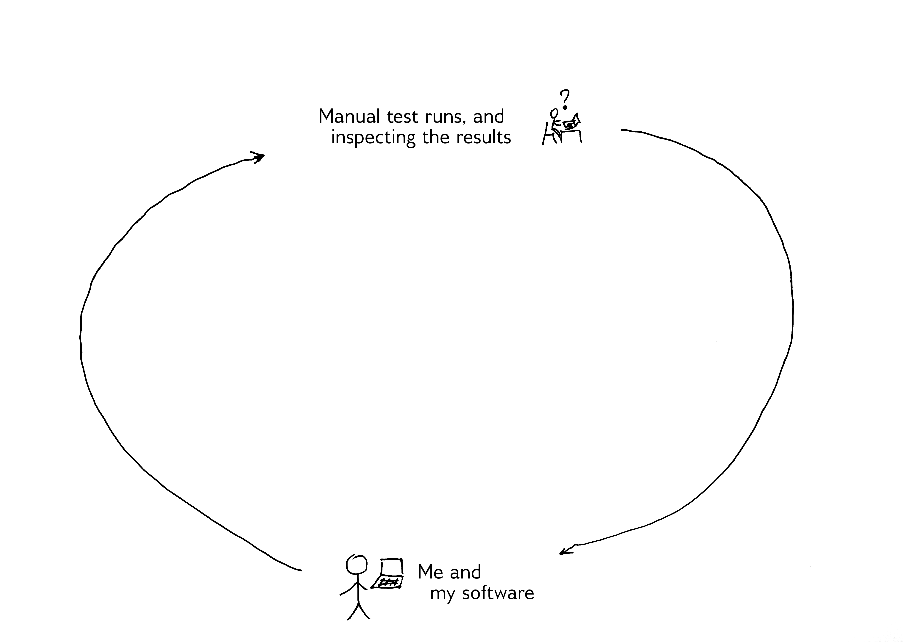
Notes:
The thing we do most is simply run experiments, look at the results, and see whether they appear to make sense.
This is obviously useful, though it gives us a somewhat unpredictable amount of feedback, tells us nothing about anything we forgot to measure, and can take an appreciable amount of time.
Also, if we don’t know the expected output of an experiment, we may be unable to distinguish between genuine experimental results and artifacts of errors in the code. At this point, we are relying more on intuition than anything else.

Slide 8
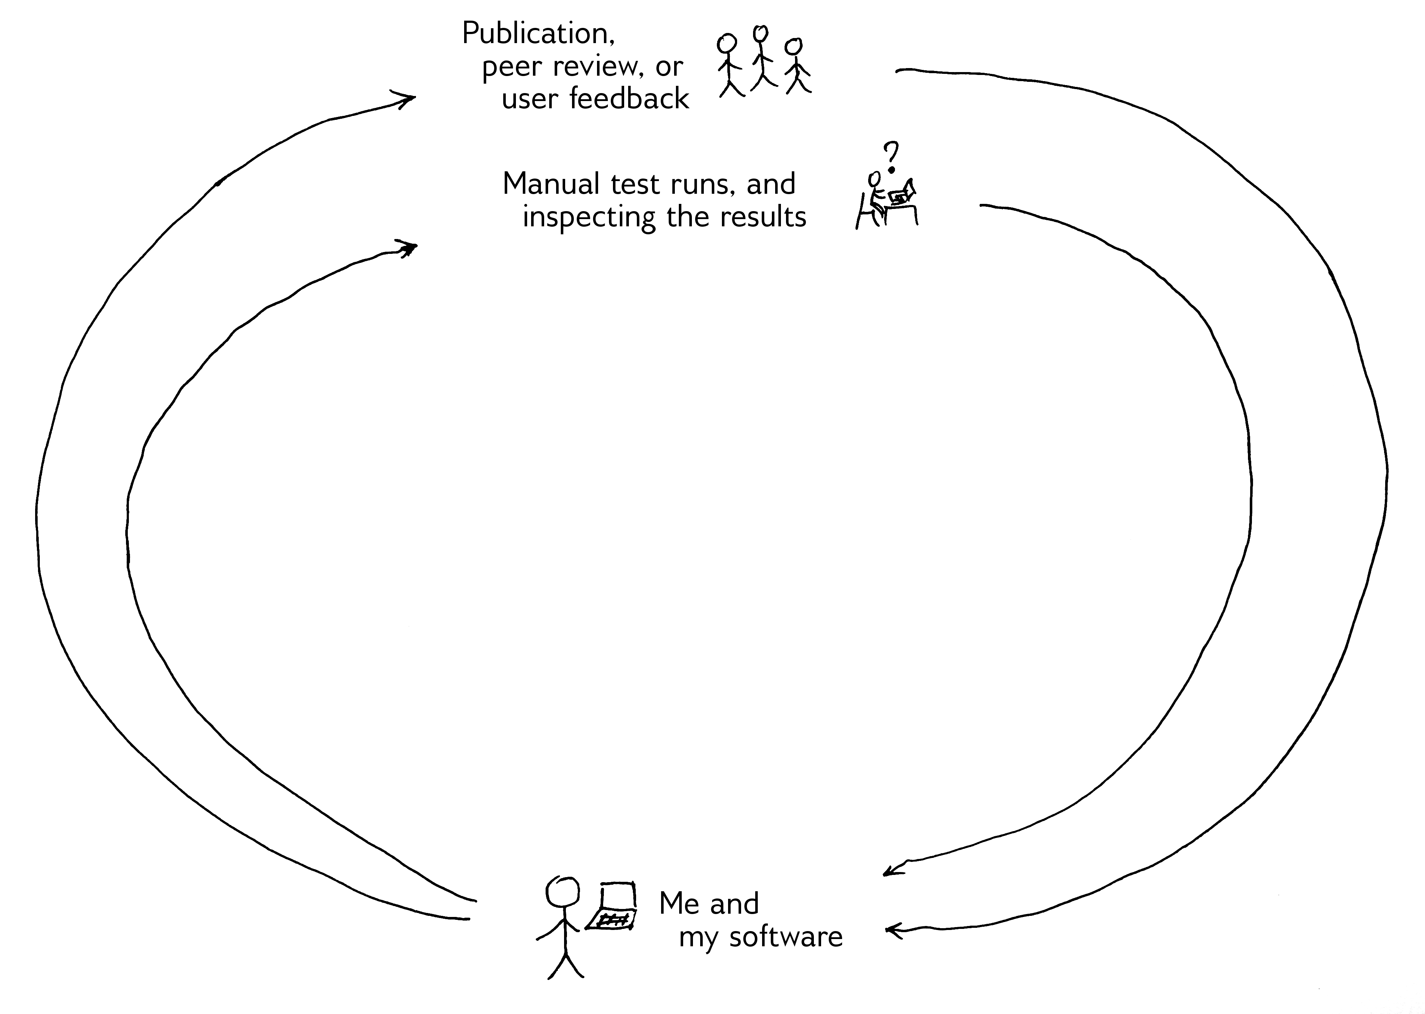
Notes:
In the scientific community, in theory we also have a feedback loop like this one: I publish my code, others read or use it (in peer review, when reading a publication, or simply as users) and they give me feedback.
Of course, this only works if we publish code at all!
Even then it is very slow – up to two years for journal publications – and unreliable.
Readers and users don’t always supply feedback, and we aren’t always in a position to act meaningfully on it if they do.

Slide 9
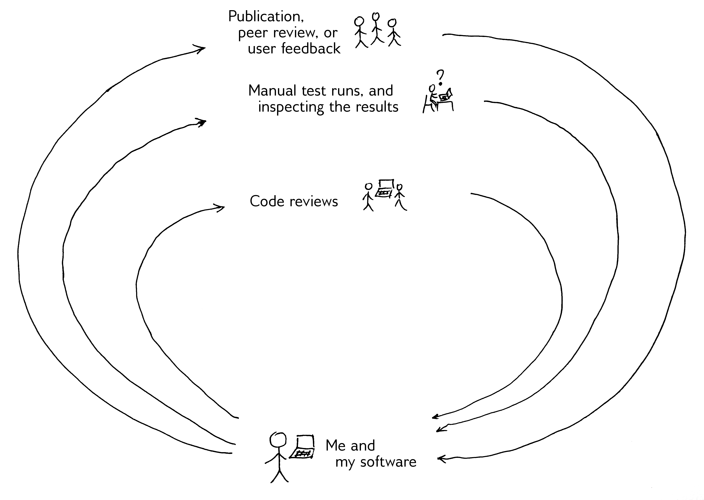
Notes:
An obvious way to get feedback more quickly is to get other people to read over our code before we run any significant experiments with it.
This is known as a code review or code inspection, and is analogous to proof-reading a paper publication.
Code reviews are more effective at finding errors than any other commonly used software development technique (Robert L Glass, “Inspections – Some Surprising Findings”, 1999).

Slide 10
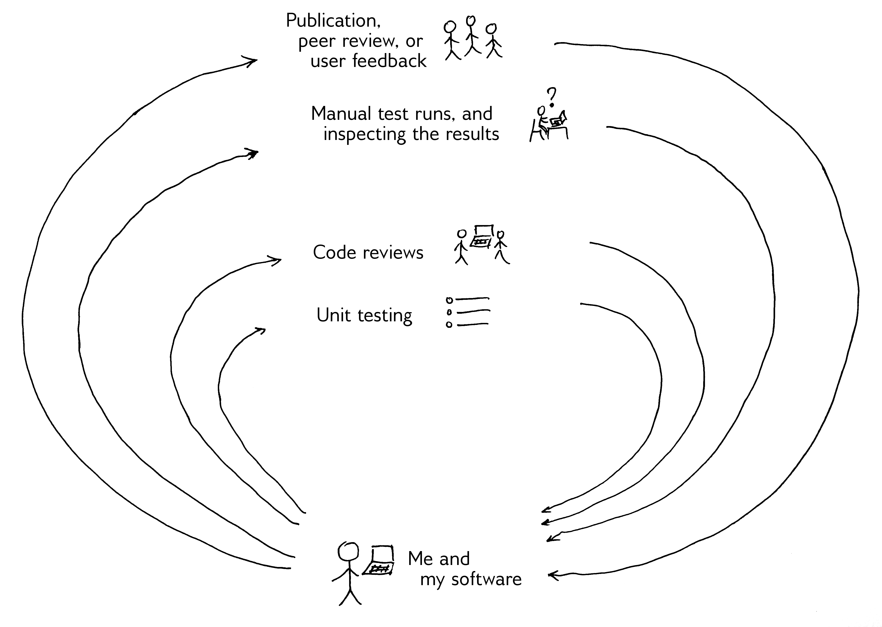

Slide 11
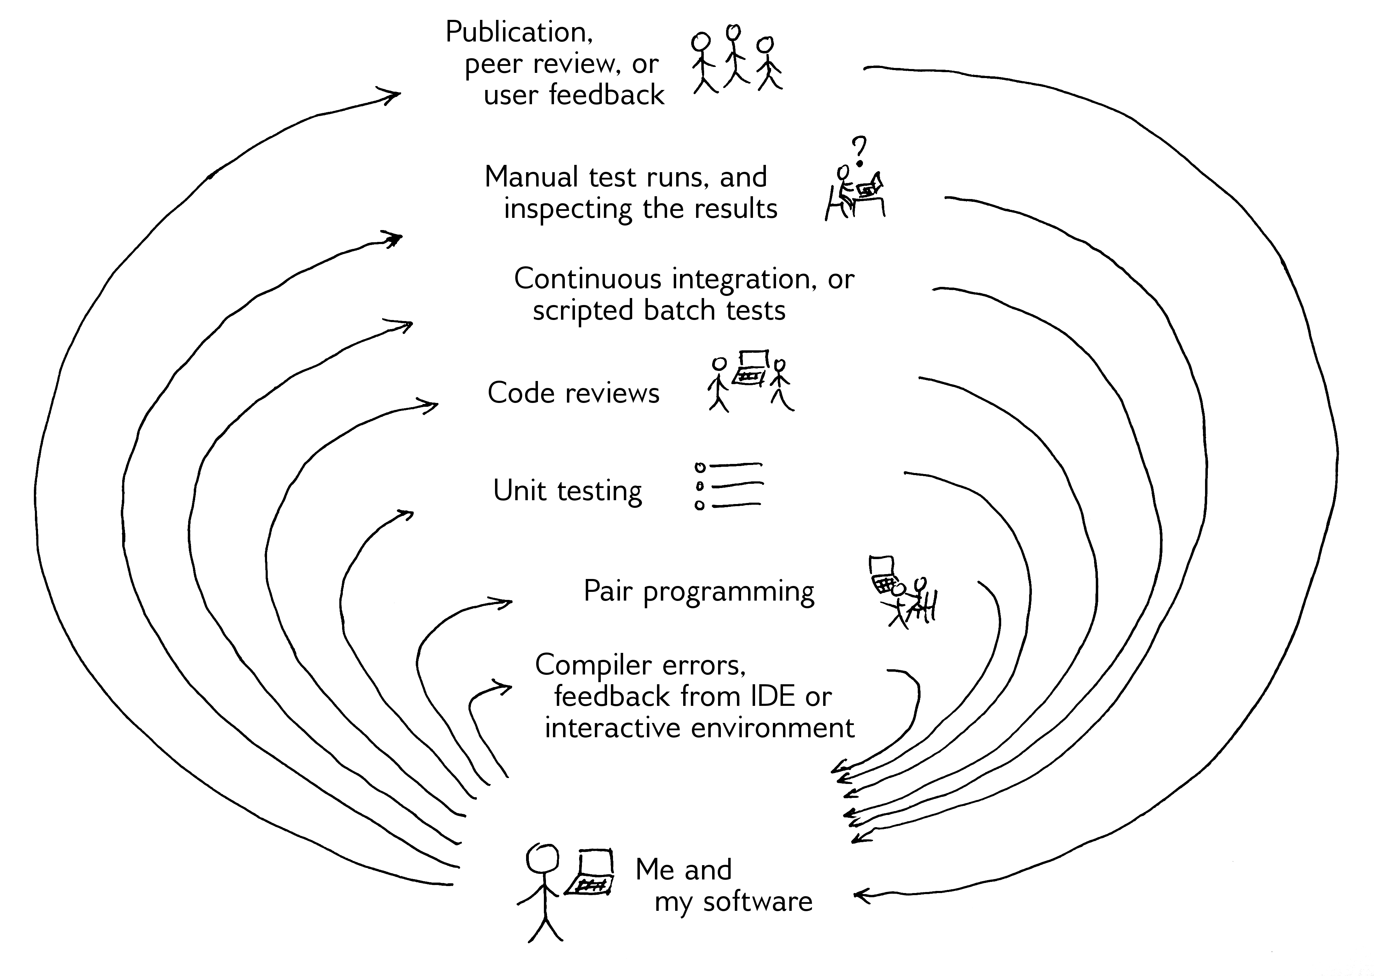

Slide 12
A philosophical point
Much of this involves becoming more comfortable with the idea that someone else will be looking at your code.
(We collaborate on papers; why not so much on code?)
Coding with readers in mind makes some things easier:
Easier to write comments you'll understand later
Easier to write testable code, and to do unit tests for it
Easier to do code reviews
Easier to contemplate publishing it!
Notes:
In our survey, 51% of respondents who reported developing software said that their code never left their own computer. (Cannam, Figueira and Plumbley, "Sound Software: Towards Software Reuse in Audio and Music Research", ICASSP, 2012.)

Slide 13
“Code reviews”
Simply: getting someone else to read your code!
Can be informal, in a peer setting
use-case reviewing: following the flow from known inputs
Or a bit more formal
checklist reviewing: looking for likely troublespots
Can move from one to the other through simple application of experience!
Notes:
In Stan Rifkin and Lionel Deimel, “Applying program comprehension techniques to improve software inspections“, 1995, the authors found that giving developers training in (essentially) “how to read code” made a very substantial difference to the number of errors they found during code reviews, as compared with more formal techniques such as inspection checklists.

Slide 14
Readable code is reviewable code
How to make code easier to read?
Sensible variable names: distinctive, meaningful, not too long
Slice code up into small functions: one function one purpose
Plan functions by thinking about inputs and outputs first (the API), rather than how they’ll work internally
Write comments that explain the why, not the how
But: “Don't comment it, fix it”
Can you read your code aloud?
Notes:
If the Rifkin and Deimel study shows that improving reviewers’ program comprehension skills leads to better reviews, that suggests that program comprehension is a problem for reviewers (and developers generally?) in the first place.
Which in turn suggests one really needs to write code in such a way as to be comprehended as easily as possible!

Slide 15
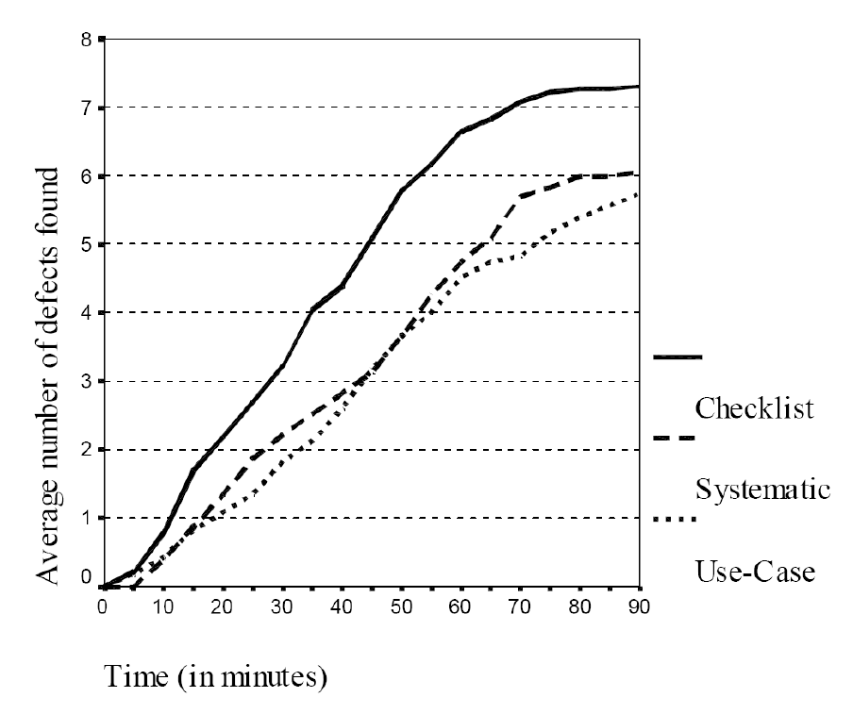
Code reviews? No problem
Dunsmore, Roper, Wood, 2000.
From Best-Kept Secrets of Peer Code Review, Cohen, 2006
Notes:
Figure from Dunsmore, A., Roper, M., Wood, M. "Object-Oriented Inspection in the Face of Delocalisation", Proceedings of the 22nd International Conference on Software Engineering (ICSE) 2000 as quoted in Jason Cohen, "Best-Kept Secrets of Peer Code Review", 2006. Figure shows elapsed time versus cumulative number of defects found for each of the three types of review. The defect rate is constant until about 60 minutes into the inspection at which point it levels off with no defects found at all after 90 minutes.
In this figure, "checklist" reviewing involves the reviewer checking for a pre-listed series of common types of error. The "systematic" review is more specific about code points to inspect, with a view to potentially providing some automation for the review. The "use-case" review involves starting with information about how other code will be expected to call into the code under review: this is perhaps most similar to how a systematic review by someone else knowledgeable in the domain but not familiar with the code might proceed.

Slide 16
Unit testing: what is it?
A unit test is a bit of code that calls one of your functions, gives it some input, and tells you whether it returned the right result
Write a set of these, and you have a test suite
A test framework can help you write them more quickly; there's at least one for every programming language and environment
Should be set up so you can run all tests in one go, quickly
Notes:
“Unit testing: Why bother?”: http://soundsoftware.ac.uk/unit-testing-why-bother

Slide 17
Unit testing: what's it for?
An automated way of ensuring:
That your code's API works (i.e. that others can use it)
That the individual parts of your code work correctly
That you don't break your code when changing it
Also useful when developing a tricky algorithm (using test-first, or test-driven development)
Notes:
“Unit testing is something I wish I’d discovered fifteen years ago: it would have taken six months off my PhD.” – Paul Walmsley, presenting “The Joy of Reproducibility” at the SoundSoftware Workshop 2012 (http://soundsoftware.ac.uk/soundsoftware2012#os1t2)
Unit testing is just a tool -- it doesn't guarantee that your program produces the right results, and it is possible to over-test (i.e. to spend too long writing tests and not long enough actually working on your method). But it is a very useful tool to help maintain the correctness of programs as they grow.

Slide 18
Unit testing questions
“How do I write tests when I don't know what results to expect?”
Notes:
Or: “If I knew what the test outputs should be, I’d already know the results and I wouldn’t need to do the experiment!”
A very reasonable question.

Slide 19
Unit testing questions
“How do I write tests when I don't know what results to expect?”
Break it down into functions whose behaviour you can predict
Test individual components, not the whole thing
Testable code is also more readable code (and so more reviewable code, and…)
Unit testing is about trying to ensure that the code implements the method—not that the method is the right one
Notes:
Indeed, if you don’t know how to test your code, how will you ever know whether the results it produces are the right ones?
It’s a bit like an engineering version of proving a mathematical theorem with a series of consistent steps. If you can test the individual parts, then you have gone a long way toward showing that the result of assembling them may be correct.

Slide 20
Unit testing questions
“How do I write tests when I don’t know what results to expect?”
“...if we’ve learned anything from the agile movement in the last 15 years, it’s that the more improvisatory your development process is, the more important careful craftsmanship is as well—unless, of course, you don’t care whether your programs are producing correct answers or not.”
http://software-carpentry.org/2012/09/not-really-disjoint/

Slide 21
Unit testing questions
“What sort of test data and test cases should I write?”
The simplest possible ones!
Include a “null” input test (e.g. silent signal)
“But I have big data sets and complex results!”
Don't use real-world data: that's a different kind of test
Look for the smallest possible input to test a given behaviour

Slide 22
An example
Audio-to-note system for solo vocal music recordings: http://code.soundsoftware.ac.uk/projects/cepstral-pitchtracker
Short-time Fourier transform using FFT library
Transform to cepstral domain
Peak finder and interpolator
Multi-agent method for identifying candidate notes

Slide 23
An example
We don’t know what output we expect for real-world data, but each of its components can be tested
Short-time Fourier transform using FFT library ✔
Transform to cepstral domain ✔
Peak finder and interpolator ✔
Multi-agent method for identifying candidate notes ✔
Notes:
See https://code.soundsoftware.ac.uk/projects/cepstral-pitchtracker/repository/show/test for the tests in this example.
Once the components have been tested individually, they can more readily be reused in further experimental work.

Slide 24
Version control
Software to help keep track of changes made to files
Tracks the history of your work
Helps you collaborate with others
Popular examples include git, Mercurial, Subversion
Notes:
See also "Why use version control?" http://soundsoftware.ac.uk/why-version-control

Slide 25
Keeping track of history
How do you get back to that working version you had yesterday?
How do you get from “it’s not working!” to understanding what went wrong?
How would you repeat the experiments from that journal paper you wrote last year?

Slide 26
Collaborating... with yourself!
You need to run the same software on your laptop at home and the server in the lab:
How do you get the code onto both?
How do you verify that you have the same code on both?
Notes:
The consistency guarantee (identifying versions, and identifying whether something has been changed from a given version and if so how) is the most powerful aspect here, and the one that distinguishes a version control system from a synchronisation and backup tool such as Dropbox.

Slide 27
Collaborating with others
You're working on code or a paper with a colleague...
How do you find out when they change something?
How do you merge your changes without getting in a mess?
How can you find out which of you introduced a bug, and when?

Slide 28
Version control helps with all this
A version control system
Records your files' history for you
Shows differences between different versions
Handles sync between copies on different computers
But you do have to work a bit:
Tell it which files are part of your project
Tell it when you've changed something
If two people make conflicting changes, one of them must resolve them

Slide 29
Version control systems
Subversion: Centralised
one server, one repository database
every commit goes straight to the shared repository
Mercurial, git: Distributed
every working copy has complete repository in it
commits are local, then push/pull between computers
e.g. work locally, then push to a remote hosting site

Slide 30
Version control hosting sites
General-purpose :
GitHub: very popular for sharing Git repositories
BitBucket: Git and Mercurial, good private repo support
SourceForge: the old-school option for open source projects
Thematic:
code.soundsoftware.ac.uk: for the UK audio and music research community
Very specific:
Does your department provide hosting?

Slide 31
How is that different from Dropbox?
Consistency guarantees:
Software needs to be exactly as written across all files
Files changed together must be updated together
Changes to a file by different people must be merged correctly
Record keeping:
Publish and replicate history reliably
Interrogate past changes and find out what version you are looking at

Slide 32
Typical version control questions
When should I start using version control for my project?
Which files should I track in the repository?
How often should I commit?
How often should I push changes to a shared repo?
Notes:
Typical answers:
When you start the project. With a distributed version control system, sticking “the current directory” under version control is trivial and nothing is wasted if you later decide to abandon the work.
Source code files and text documentation. Outputs of the build process should not go under version control (changes to them are not usually meaningful enough) and substantial binary data files generally aren’t managed well.
Whenever you have a set of edits that you can identify as a meaningful change. My rule of thumb – because I have quite a poor memory – is that I should commit when I realise I’m at risk of forgetting what my earliest outstanding changes were for, perhaps because I’m about to move on to changing something slightly different.
Usually at the end of a working day. But this really depends on whether, and how, you are working with others.

Slide 33
Five things to do tomorrow
Get your current research code into a version control repository, push to a hosting site (a private project is fine)
Pull it onto another computer, get it to build and run
Talk to another researcher in your group, allot an hour to experiment with reviewing a bit of each other's code
Identify a piece of your code that you can isolate and test
Pick a licence for your code, check compatibility with other code you're using, add it to code files
Notes:
See also:
“Getting started with your software and our project site”: http://soundsoftware.ac.uk/getting-started-soundsoftware-code-site
“Unit testing: Why bother?”: http://soundsoftware.ac.uk/unit-testing-why-bother
“Open source software licences explained”: http://soundsoftware.ac.uk/open-source-software-licences-explained

